Slide 1
The Arduino Microcrontroller small but Mighty
Why bother learning about something like this?
What is this tiny device?
How does someone design with hardware and software?
Ok, Let’s see a demonstrations and examples
Bruce Bream
tarrow@roadrunner.com
April 2024
Notes:
Just maybe but the end of this presentation you will find this an opportunity for a new venture and learn something new that could be used the rest of your life.

Slide 2
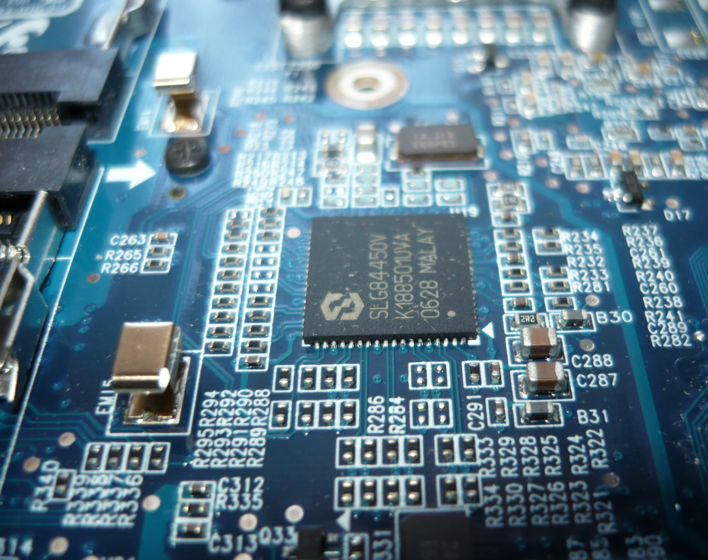
We Live In A Computer-controlled World
We rely on computer hardware and software
Cellphones
Computers / Tablets
Text and Email systems
Cars / Trucks / Motorcycles / EVs
Dishwashers / Washing Machines / Refrigerators
Heating and Air Conditioning
Medical devices
Watches / Clocks
Drones
How many people understand how these work?
Let’s start at the most basic level:
  Microcontroller programming and interfacing
This Photo by Unknown Author is licensed under CC BY-SA
Notes:
Quiz the room on how many computers are in the room or at home. How many at the conference? Over a 10,000 if you count the cars in parking lot. There’s at least 100 modules in a car, each with a microcontroller.

Slide 3
The Arduino Microcontroller – Small but Mighty
Machinery
Controls
Air Quality Data
Thermostats
Medical
Devices
Doorbell
Cameras
Light
Controls
High Altitude
Balloons
Drones
GPS Track
Data
Remote
Control
Notes:
An Arduino is capable of doing all these tasks, and more.

Slide 4

The Arduino Microcontroller – Why Learn about this?
Understand how increasing computer-controlled world operates
    Learn at a basic level of computing
Carry this knowledge to multiple fields and endeavors
  Electrical/Mechanical/Biological Engineer
  Computer Programmer
  Troubleshooting electronics/computers
  FIRST Robotics competition
  High School / College classes
  Computer User
Become one with the computer
Notes:
Programming an Arduino gives you the ability to understand how computers work at the most basic level right down to the individual bits doing the control and the hardware involved.

Slide 5

The Arduino Microcontroller
– Why start here?
Inexpensive
Free simple, clear, programming environment
Runs on Windows, Mac, Linux
Easy to learn with numerous free examples
Open-source software and hardware
Learning basics of C++ programming language
No operating system like Raspberry Pi
Power on/off without losing program
Learn basic connections with electronic parts
  Switches, Resistors, Relays, LEDs, GPS, …
Introduction to electrical schematics
Release your creativity
Notes:
The Arduino is a minimal starting point that has great potential.

Slide 6

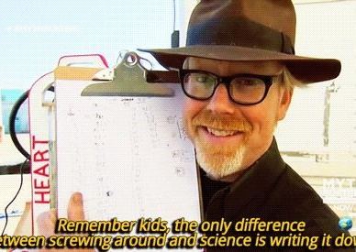

Before you start - Design rule #1
Remember kids, the only difference between
screwing around and science is writing it down.
Notes:
The only difference between screwing around and science is writing it down. I keep a notebook of all my sketches and separate folders in my computer for each design with the code and a Word or Powerpoint document describing it. Every engineer and scientist I know keeps a notebook.

Slide 7
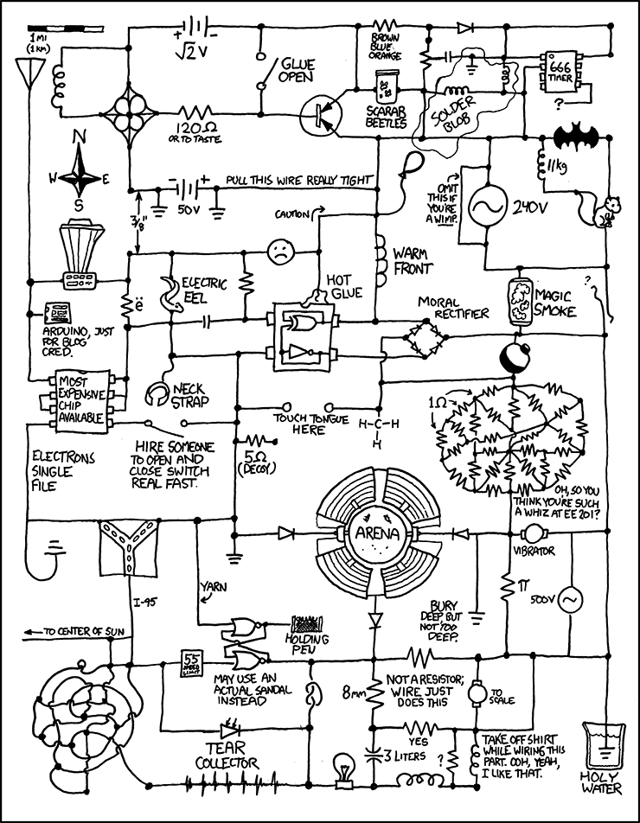
Documentation
Ok
So, this is probably too much documentation
Ref:
https://xkcd.com/730/
Notes:
Well maybe you don’t need to go this far in your documentation. Let’s look at the design process.

Slide 8
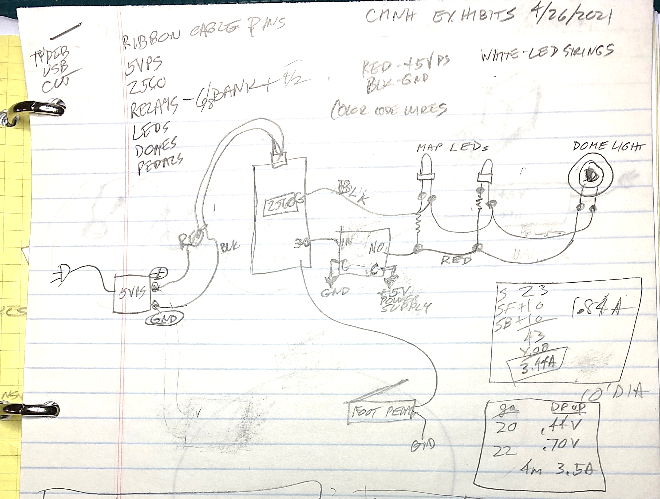
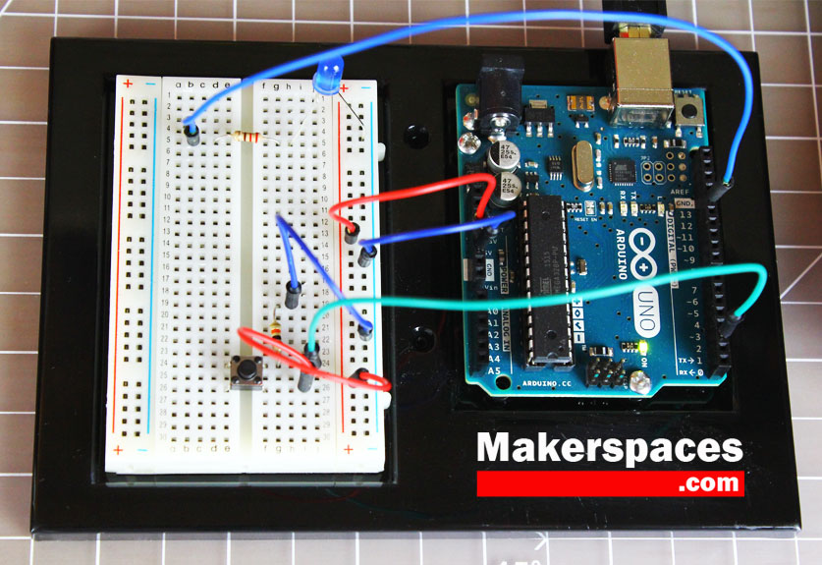
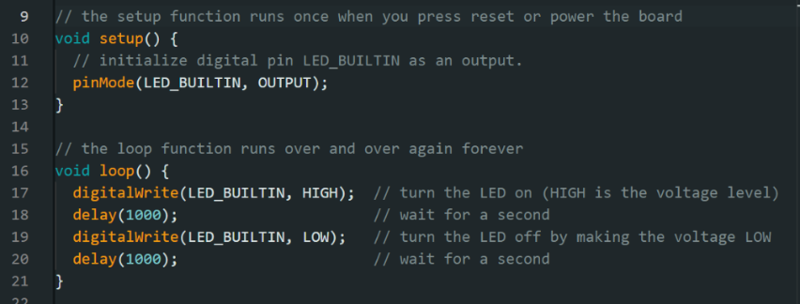
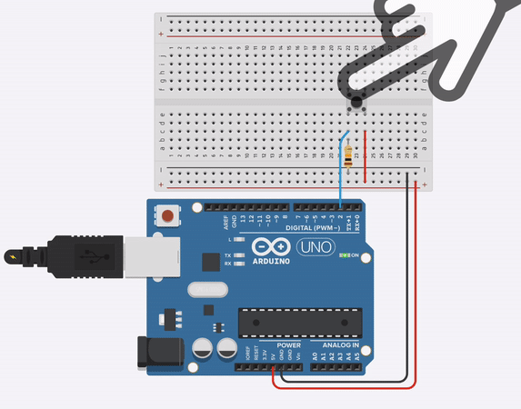
The Design Cycle
IDEAS
Write it / Sketch it
Make it / Code it
Revise
Test it
Revise
Revise
Notes:
You will learn how a design cycle works if you practice this approach used by all engineers. The sketch was for the computer-controlled lights of a public display. Calculations were for sizing the power supply.

Slide 9

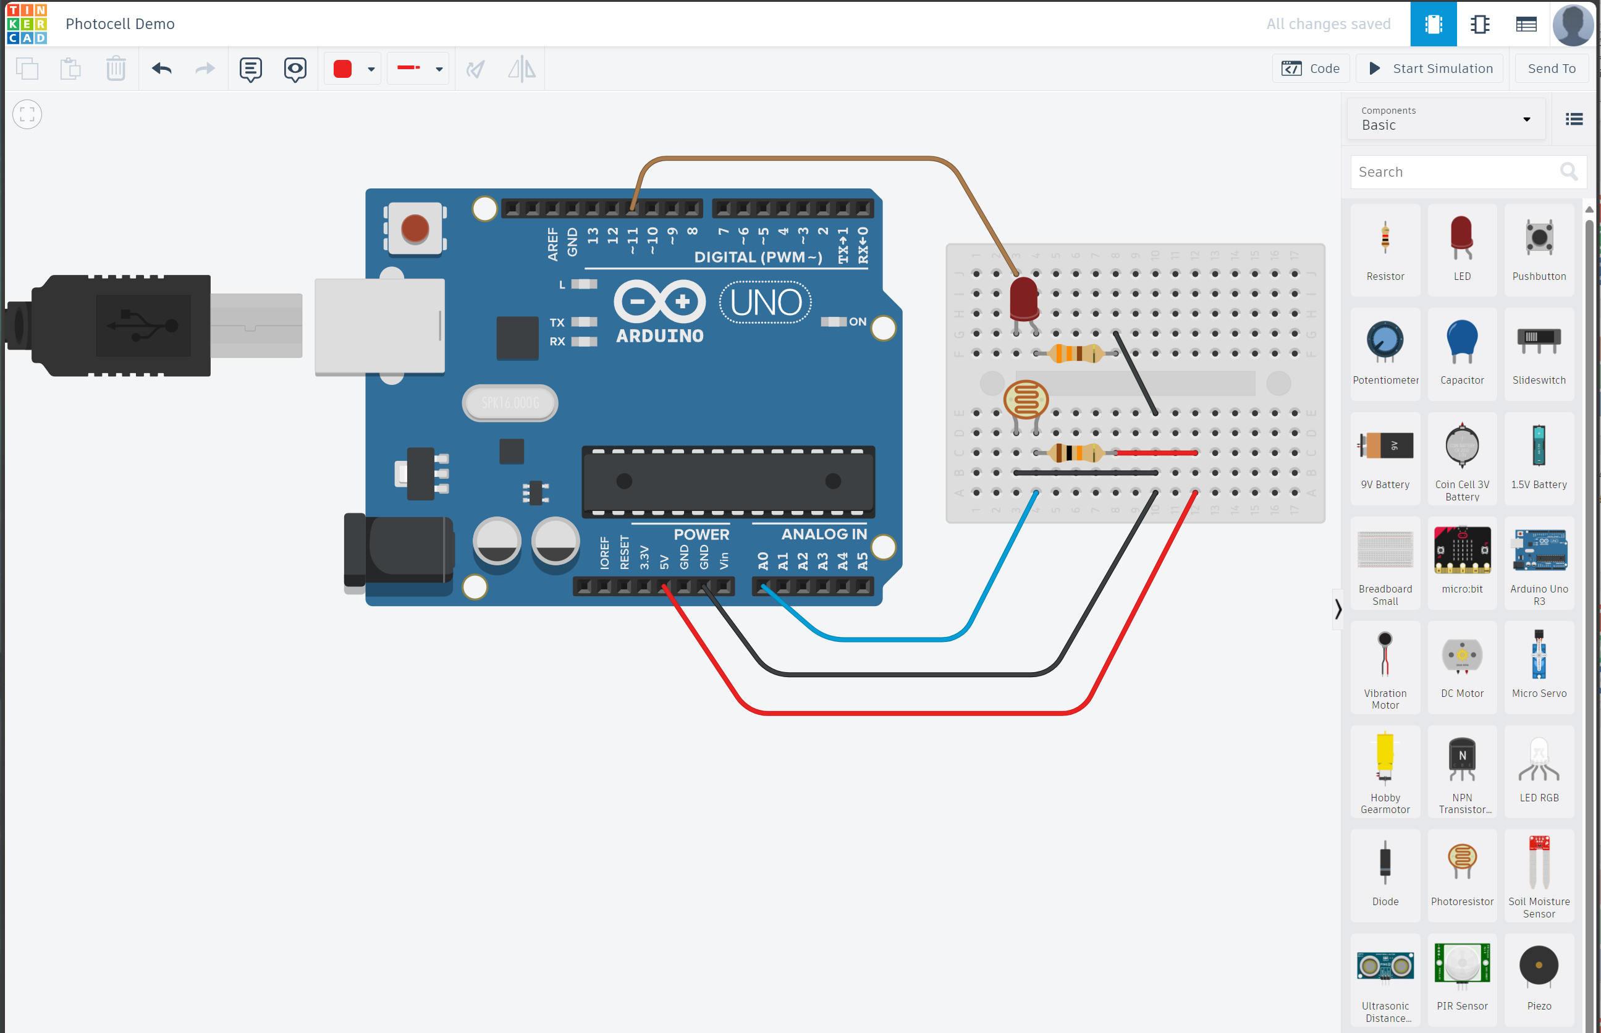
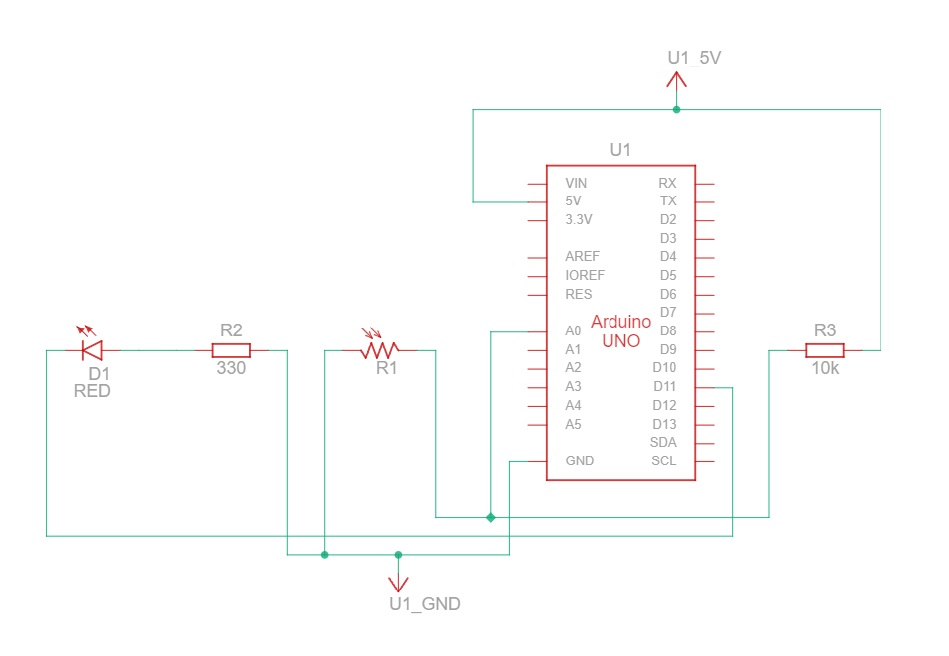
A free web-based tool for documenting your design
www.tinkercad.com
Sketch your design in pictures and have it turned into an actual electrical schematic.
Notes:
Tinkercad is a free web-based tool for electronic design. Design with physical objects as seen here, then click the circuit icon in the upper left and it generates an electrical schematic (see inset picture).

Slide 10
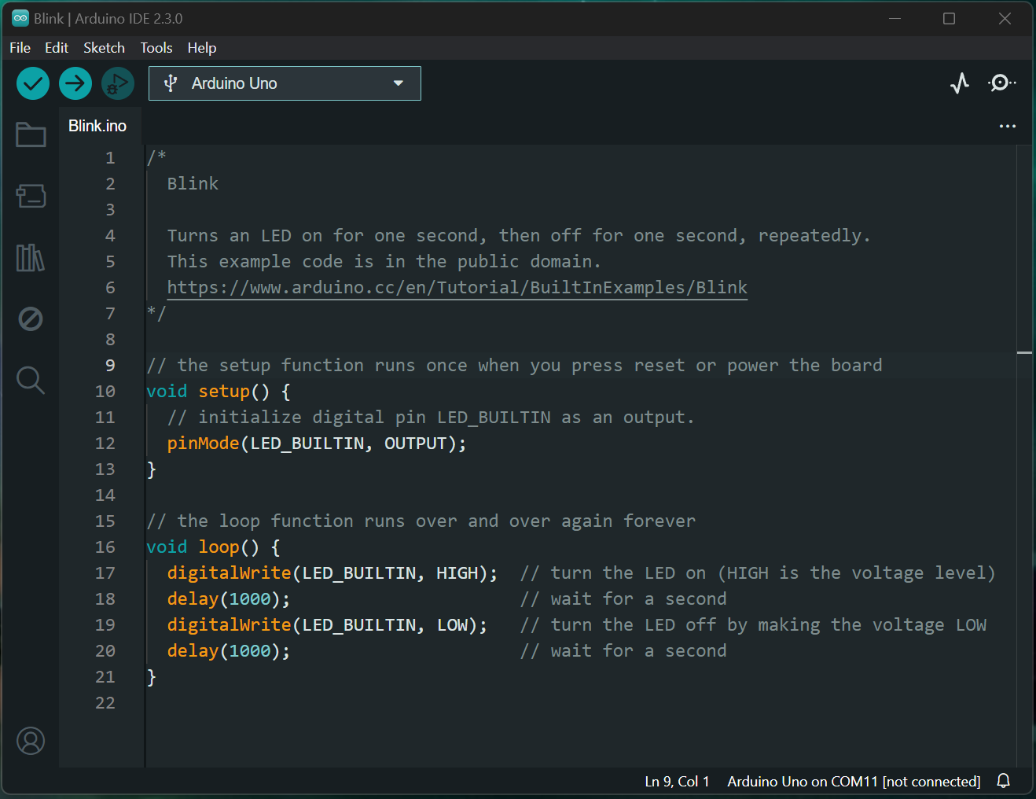
Programming – The Integrated Development Environment (IDE)
The Arduino IDE
A single app for programming, saving, documenting, and
uploading a sketch
It’s a free download for:
Windows
Mac
Linux
Find it at:
www.arduino.cc
Notes:
The free Arduino IDE makes it easy to get started with an all-in-one program for programming, saving, documenting, and uploading your program. This example will flash an LED. pinMode identifies the built-in pin where the LED is connected. The loop() runs a continuous loop of turning it on (digitalWrite) and off with delays in milliseconds. (1000 milliseconds = 1 second). Change one of the two delay() and see the LED change the on or off time.

Slide 11
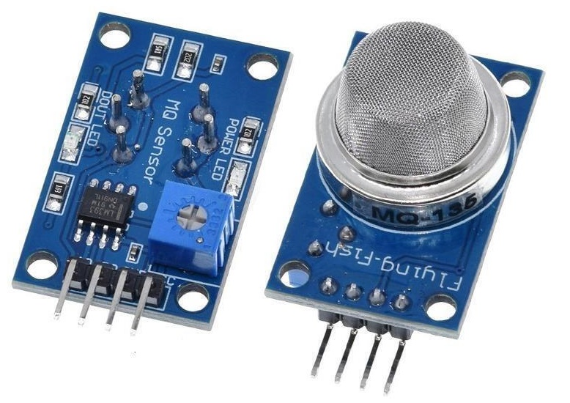
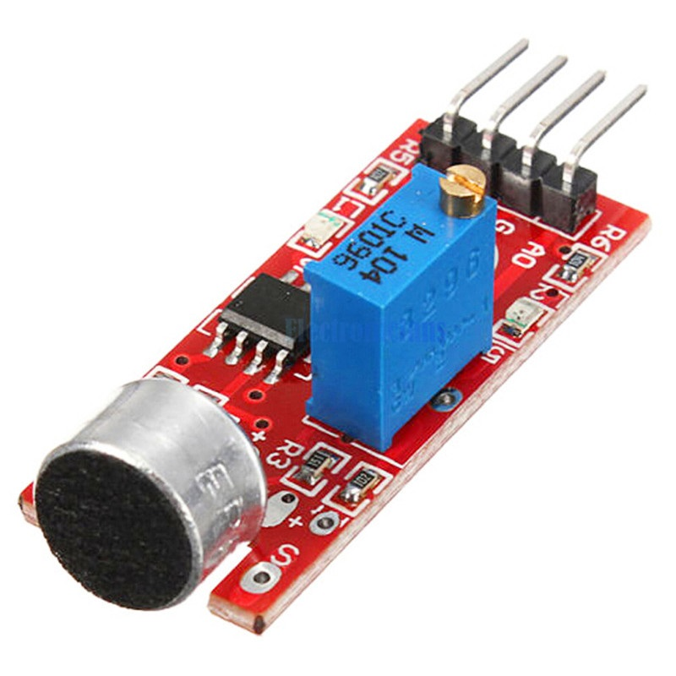
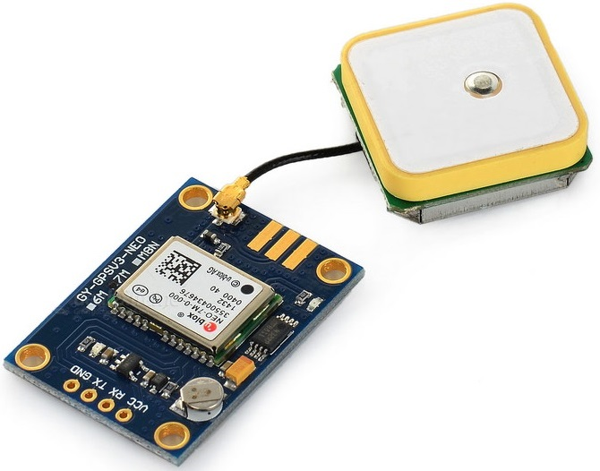
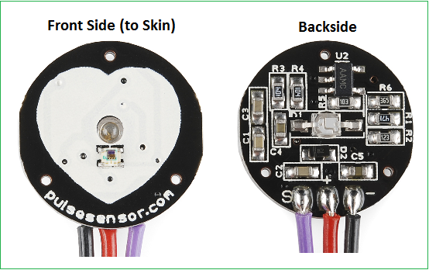
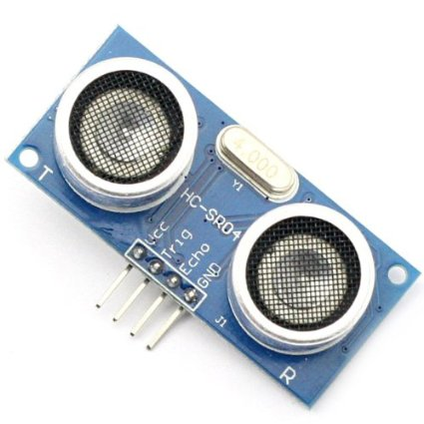
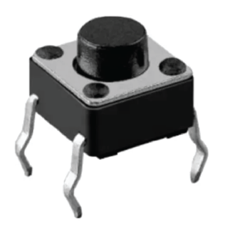
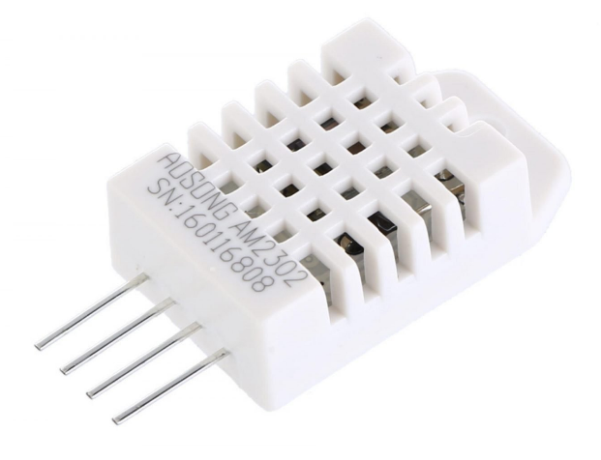
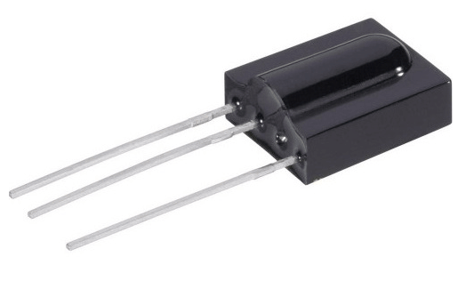
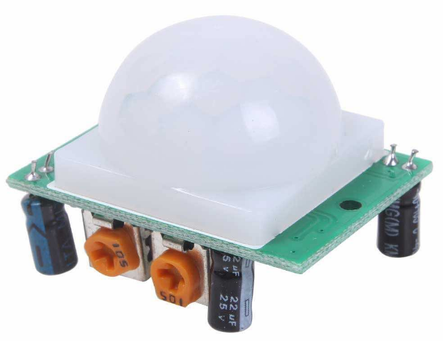
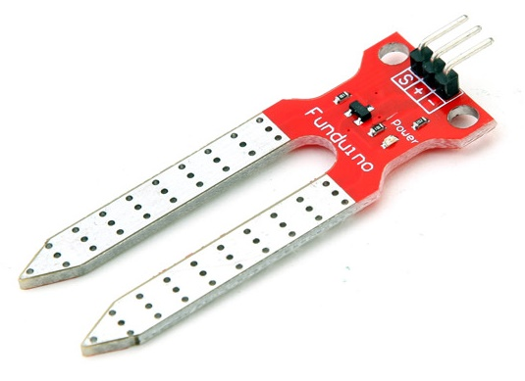
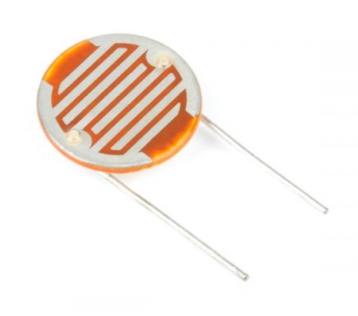
Sensors – Data at your service
Switches
Temperature/Humidity
Air Particle Sensor / CO Detector
Light sensor (Photocell)
GPS data (lat/lon, altitude, speed, direction)
Accelerometer (g forces, orientation)
Geiger counter
Motion Sensors
Cameras
Soil moisture
Ultrasonic distance measurement
Remote measurement with cellphone or radio connection
CO Detector
Microphone
GPS
Heart Rate
Distance
Switch
Temperature
Infrared
Motion
Soil Moisture
Photocell
Notes:
Knowledge of electronic component operation is part of the learning process. These are all common parts used by Arduino controllers.

Slide 12
Connections – Get Inputs, Make Outputs
Notes:
Interconnect the Arduino with components on the breadboard using plug in connection wires. A pushbutton, resistors, and an LED are used in this example.

Slide 13
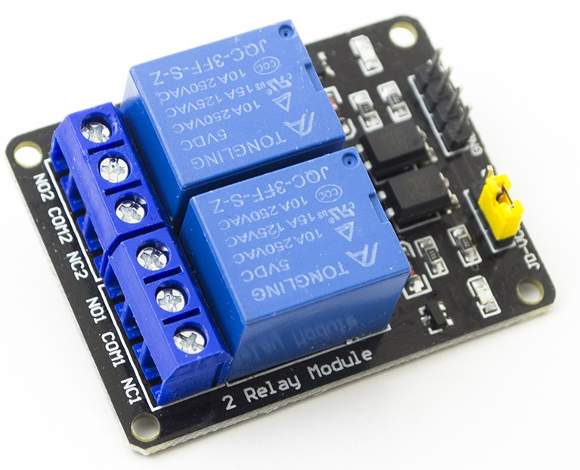
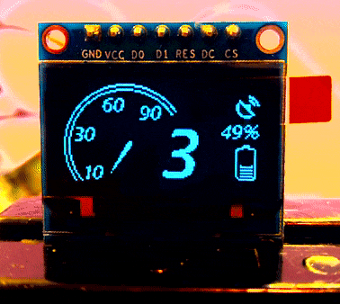
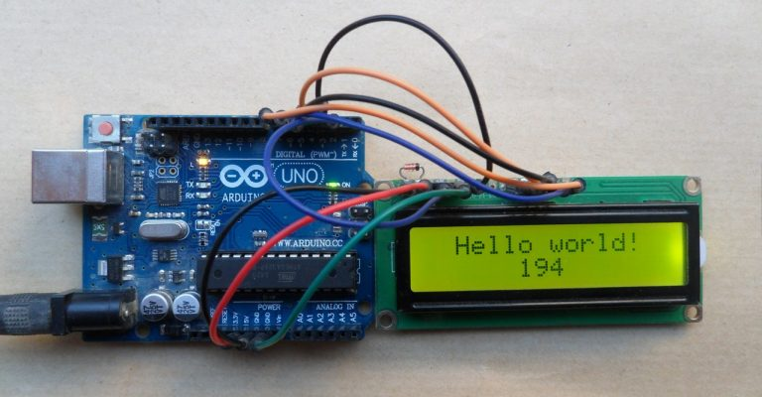
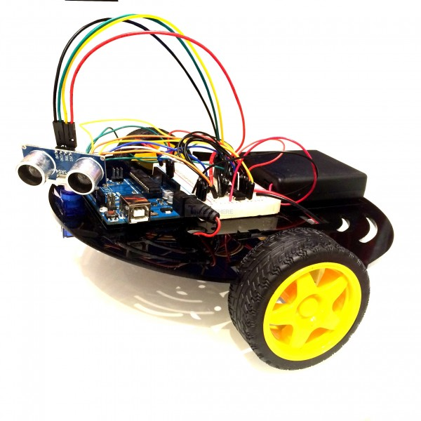
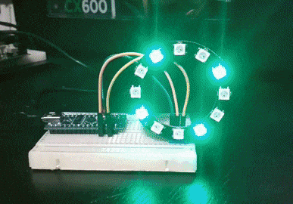
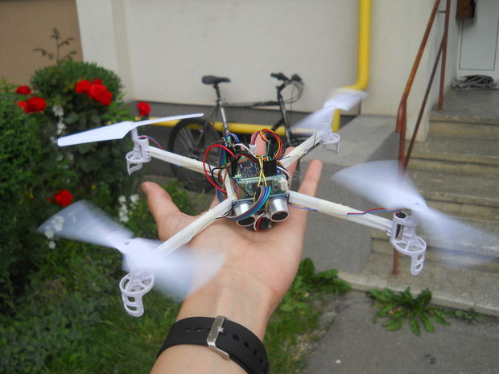
Effectors (Outputs)
Turn on an LED
  Once you learn this you can turn anything on and off
Activate a relay
Power a motor
Write data to an LCD display
Fly a drone
Control a robot
Say something
Notes:
This is finally the control part of a microcontroller. The most basic control is to just turn an output pin on and off like the blinking LED. Connect this to a relay and control higher power levels. Send a string of pulses to control flashing LED strings, an LCD display, motors or a drone.

Slide 14
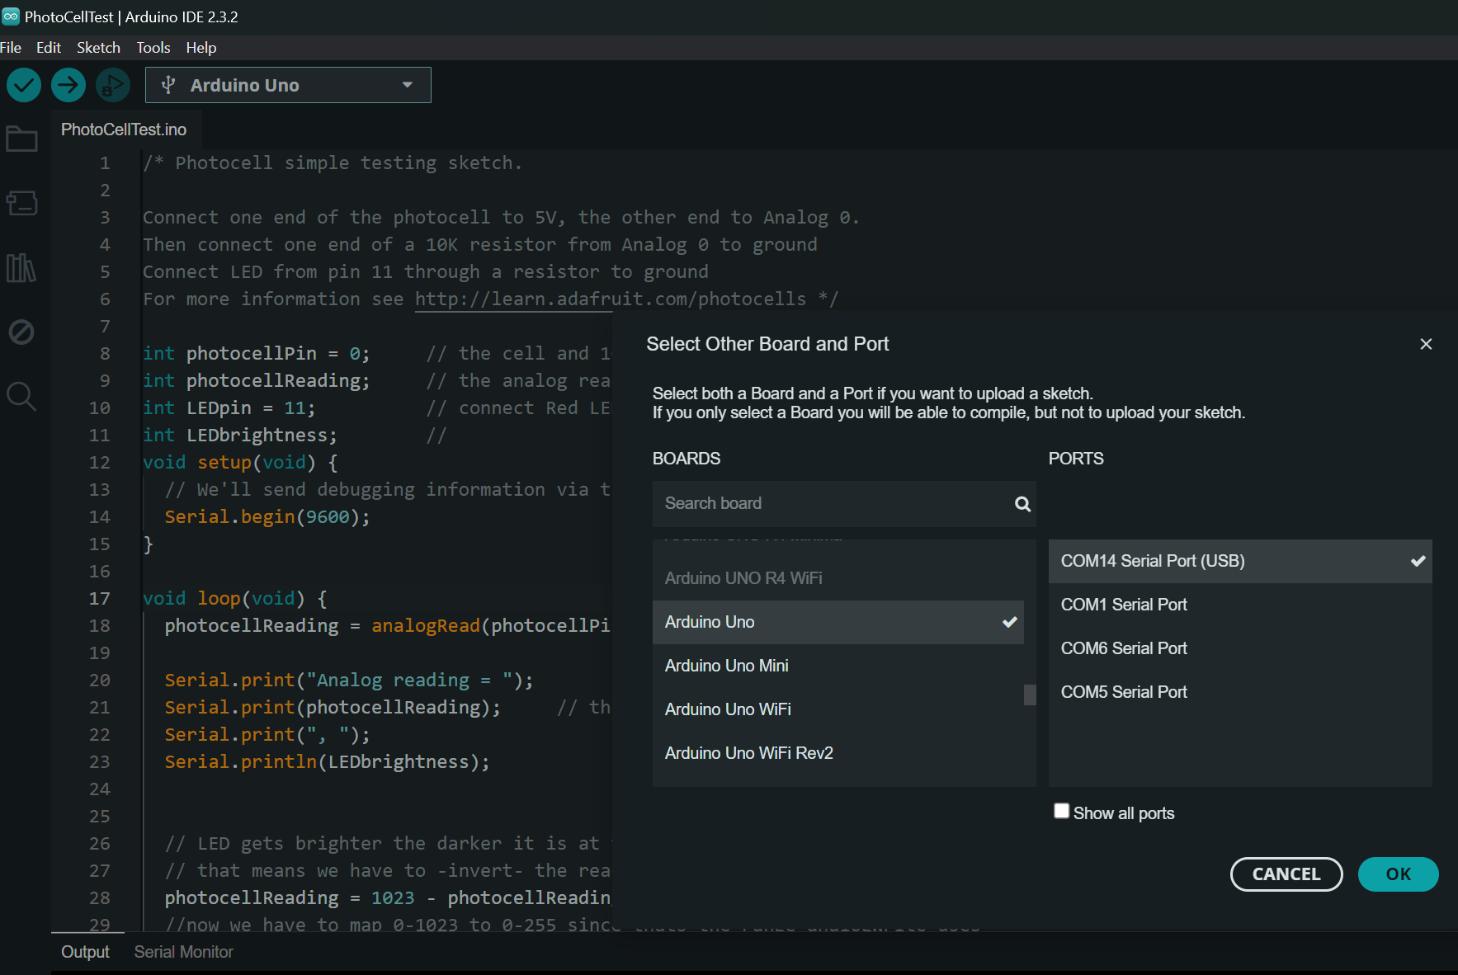
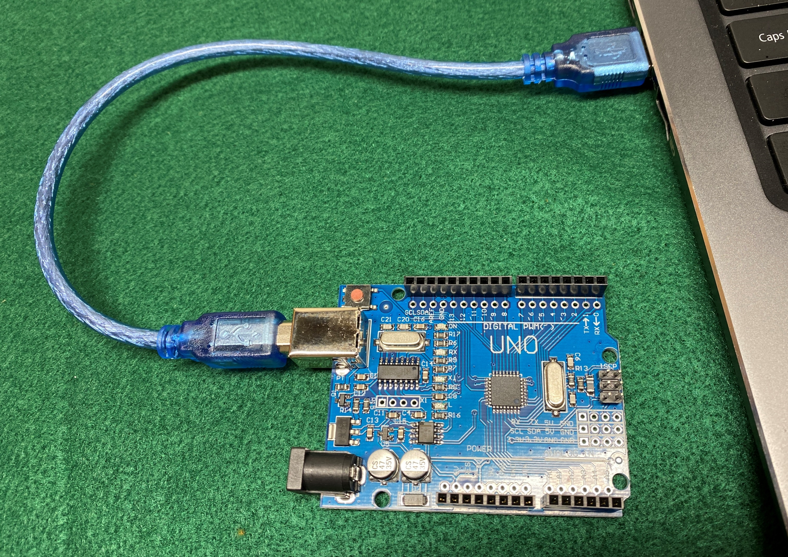
Demonstration
Connect UNO to your computer with the USB cable
Select Board and Port
Ports identify the USB socket on the PC

Slide 15
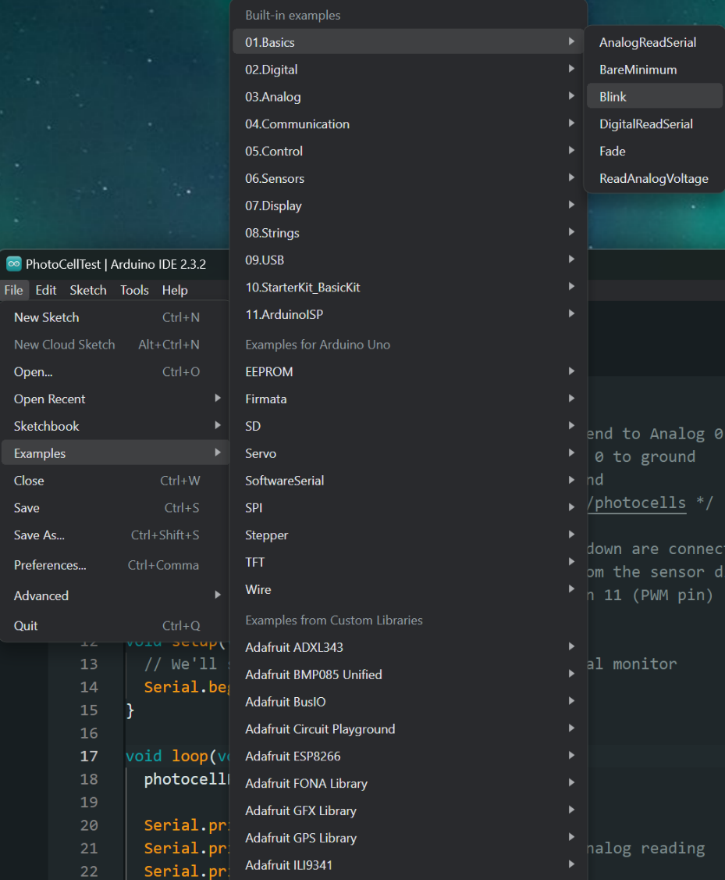
Load Your Sketch
Load the sketch from the File dropdown menu
Numerous Examples to choose from
Each input or output device comes with example sketches
Programs are called “Sketches”

Slide 16
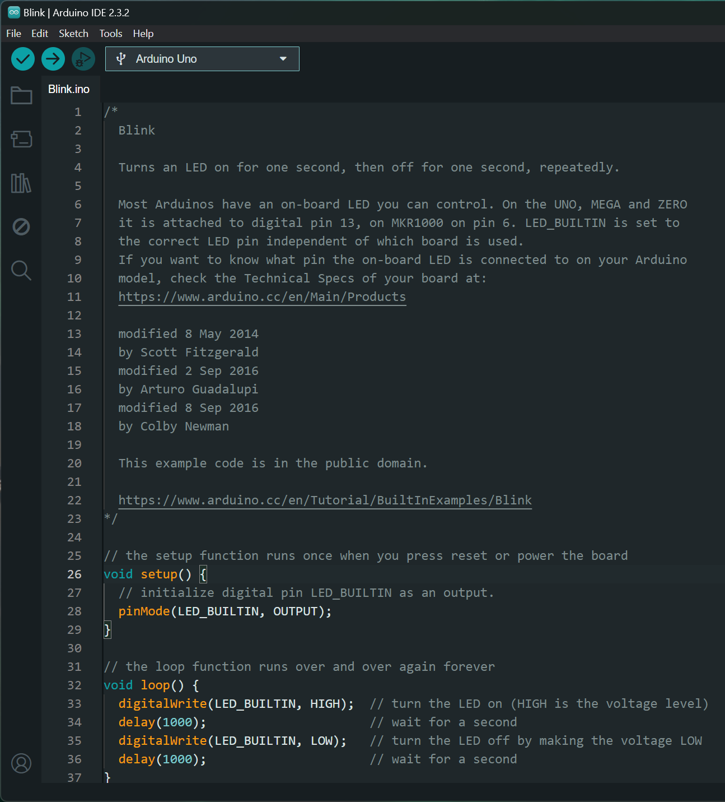
Check and Upload
Your Sketch
Check syntax with the Checkmark
Upload to the UNO with the Right Arrow
Syntax is Computer Grammer

Slide 17
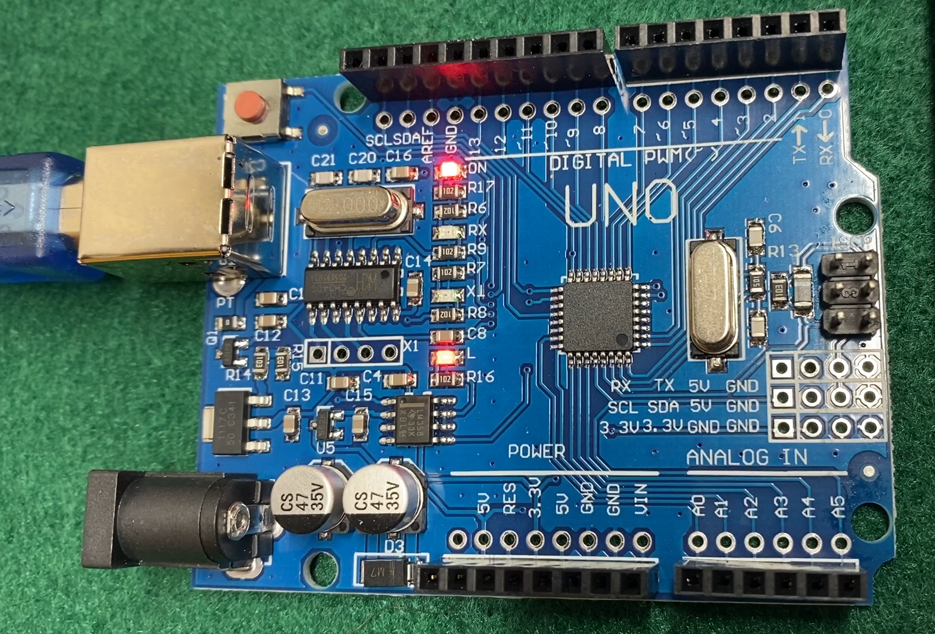
Watch Your Sketch Run - Blink
Enjoy, but now it’s time to:
Modify it
Change the blink rate
Send Morse Code
Blink external LEDs
Go on to another project
Notes:
Modify the basic Blink example to get familiar with programming and expand from there with other included example sketches.

Slide 18
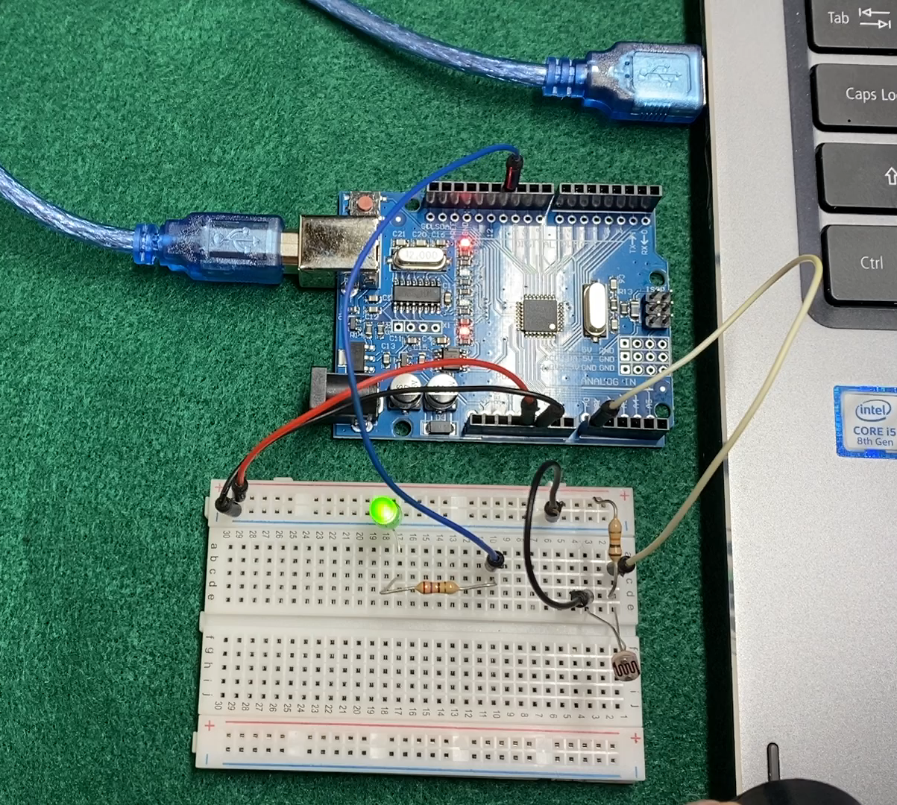
Watch Your Sketch Run – Photocell dimming an LED
Use it to match room lighting
Dim a display
Control a device with a hand waive
Record sunlight hours
Dim car headlights
Photocell
Notes:
A photocell varies its resistance with light levels. This can be measured by an analog input pin on the Arduino.

Slide 19

Arduino Controlled Example Projects
Aircraft Checklist – Display and Voice versions
Air quality monitor
Robotics
Coordination tester
String light control
24 hour Clock with DST switch
Motion sensor and flashing transponder lights
Exercycle repair
High Altitude Balloon data
Notes:
In-person examples to show you how much can be done with a simple device like an Arduino

Slide 20
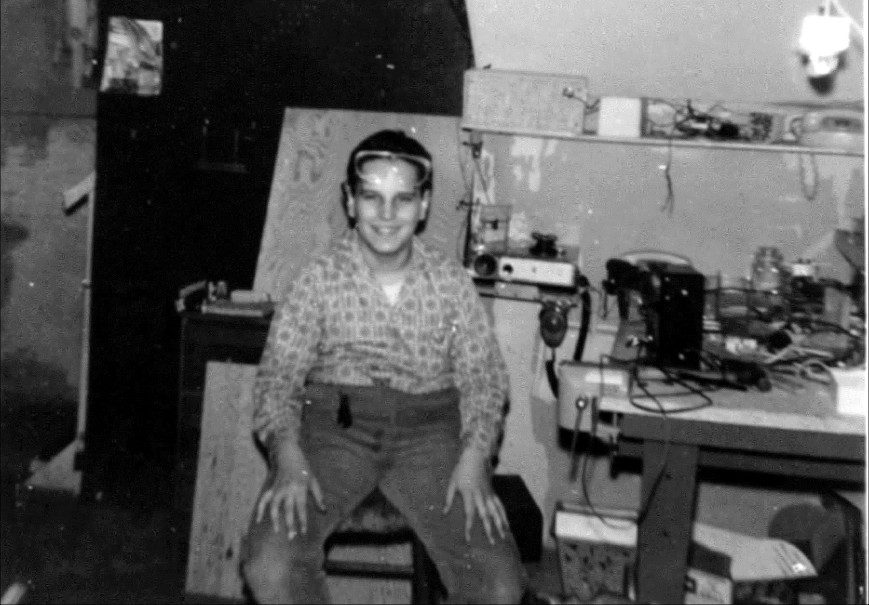
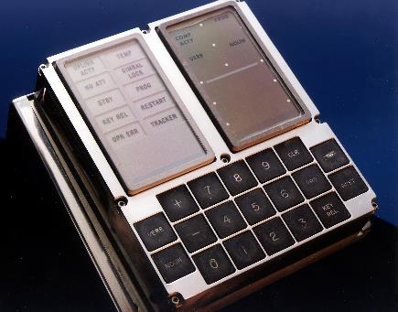
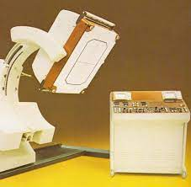
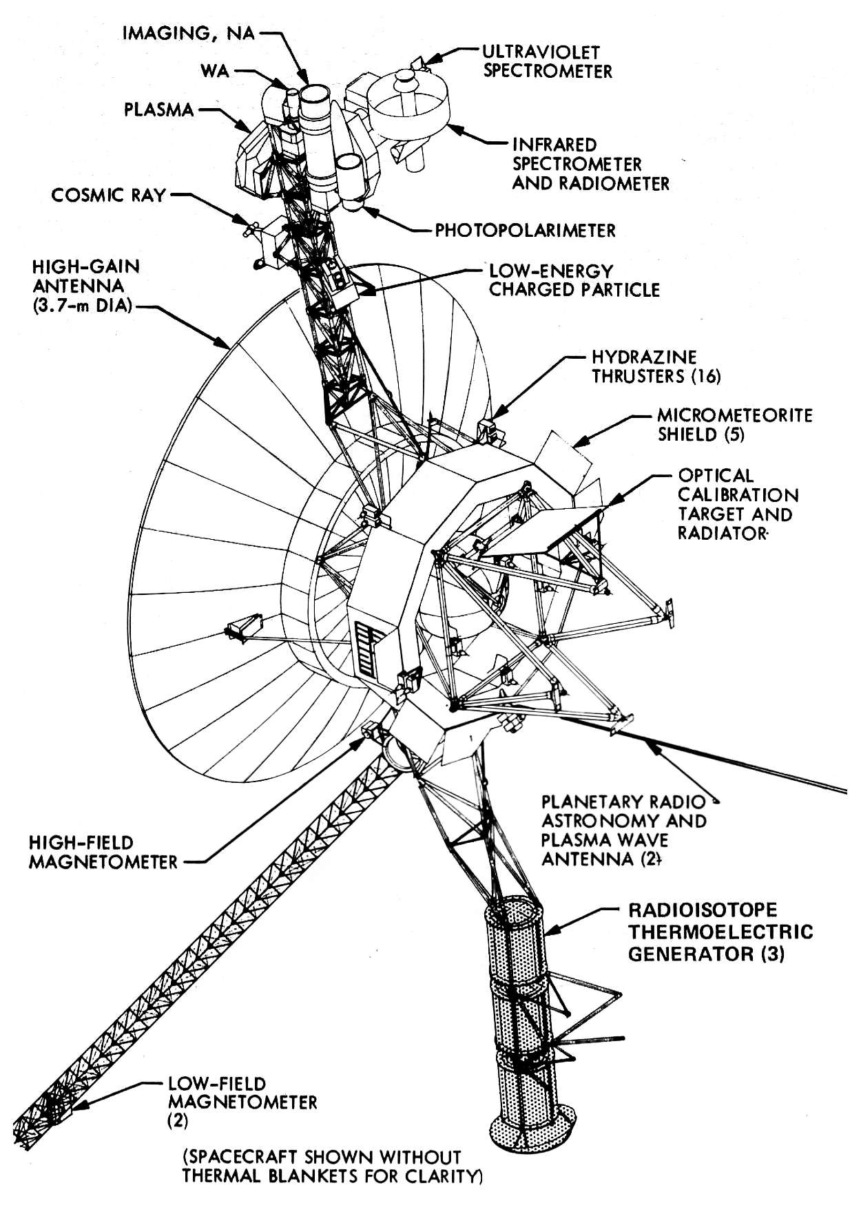
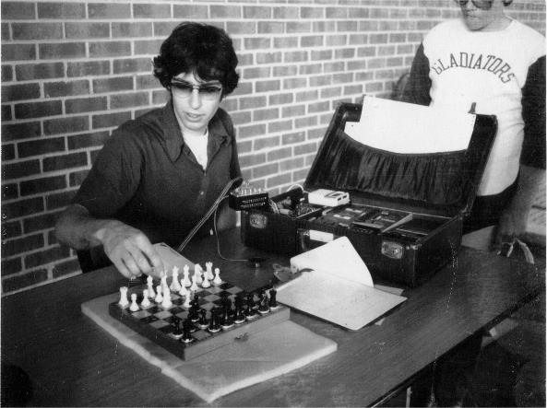
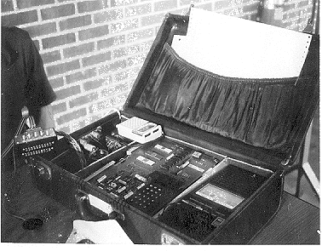
Yes, I’m an electronics Nerd from long ago – Look how far things have progressed
Circa 1960s
Vacuum tubes and switches
1969 Apollo Guidance Computer 38 kB
1MHz clock
1970s
Radioisotope Scanner
8 bit CPU with 8MB memory
1970s Voyager Spacecraft – 70 kB memory, 80k clock
Arduino UNO – 35kB, 8-bit, 16MHz clock, 26 I/O pins
1970s Computer Chess in a briefcase - 16kB memory
Notes:
Curiosity can lead you to great adventures. I started at 12 when transistors were just being developed. I shocked myself a lot on vacuum tube projects. My interest in electronics led me to meeting someone building a computer chess game with 16k of memory and program stored on a cassette player. This led to being a service technician on medical equipment and eventually working at NASA. The Arduino UNO board is only one of many with built-in functions like WiFi and Bluetooth. A small microcontroller can do amazing things like the Apollo Guidance Computer and the Cassini spacecraft.

Slide 21

Sources for Ideas, Parts, Help
Arduino.cc - www.Arduino.cc
Arduino programming IDE
Forums / Projects / Tutorials
SparkFun – www.SparkFun.com
Parts and software guides
Adafruit – www.Adafruit.com
Parts and software guides
Tinkercad – https://www.tinkercad.com
Design and prototype electronic circuits
inventr.io – inventr.io/resources
Programming examples
Microcenter (Cleveland, Columbus, Cincinnati) – www.microcenter.com
Parts
Notes:
This is only a sample of places to start learning more. The internet is full of examples and groups making microcontroller projects with the Arduino family and others.

Slide 22
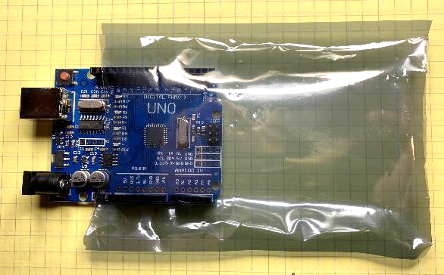
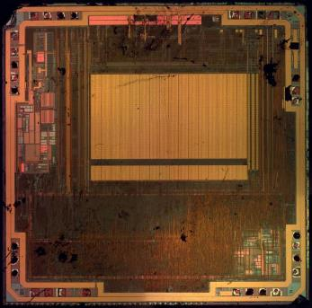
Handling Electronic Parts
Anti-static bags for sensitive parts like Arduino
Not a concern for resistors, capacitors, switches, LEDs
Sparks and arcs are fun but they can destroy an Arduino
Don’t shuffle across the room and grab your Arduino
Some IC conductors are only 2 um wide
Notes:
A note of caution when handling any microcontroller. That tiny integrated circuit (IC) has some really small connections. Static electricity can destroy the Arduino and other microcontroller ICs.

Slide 23
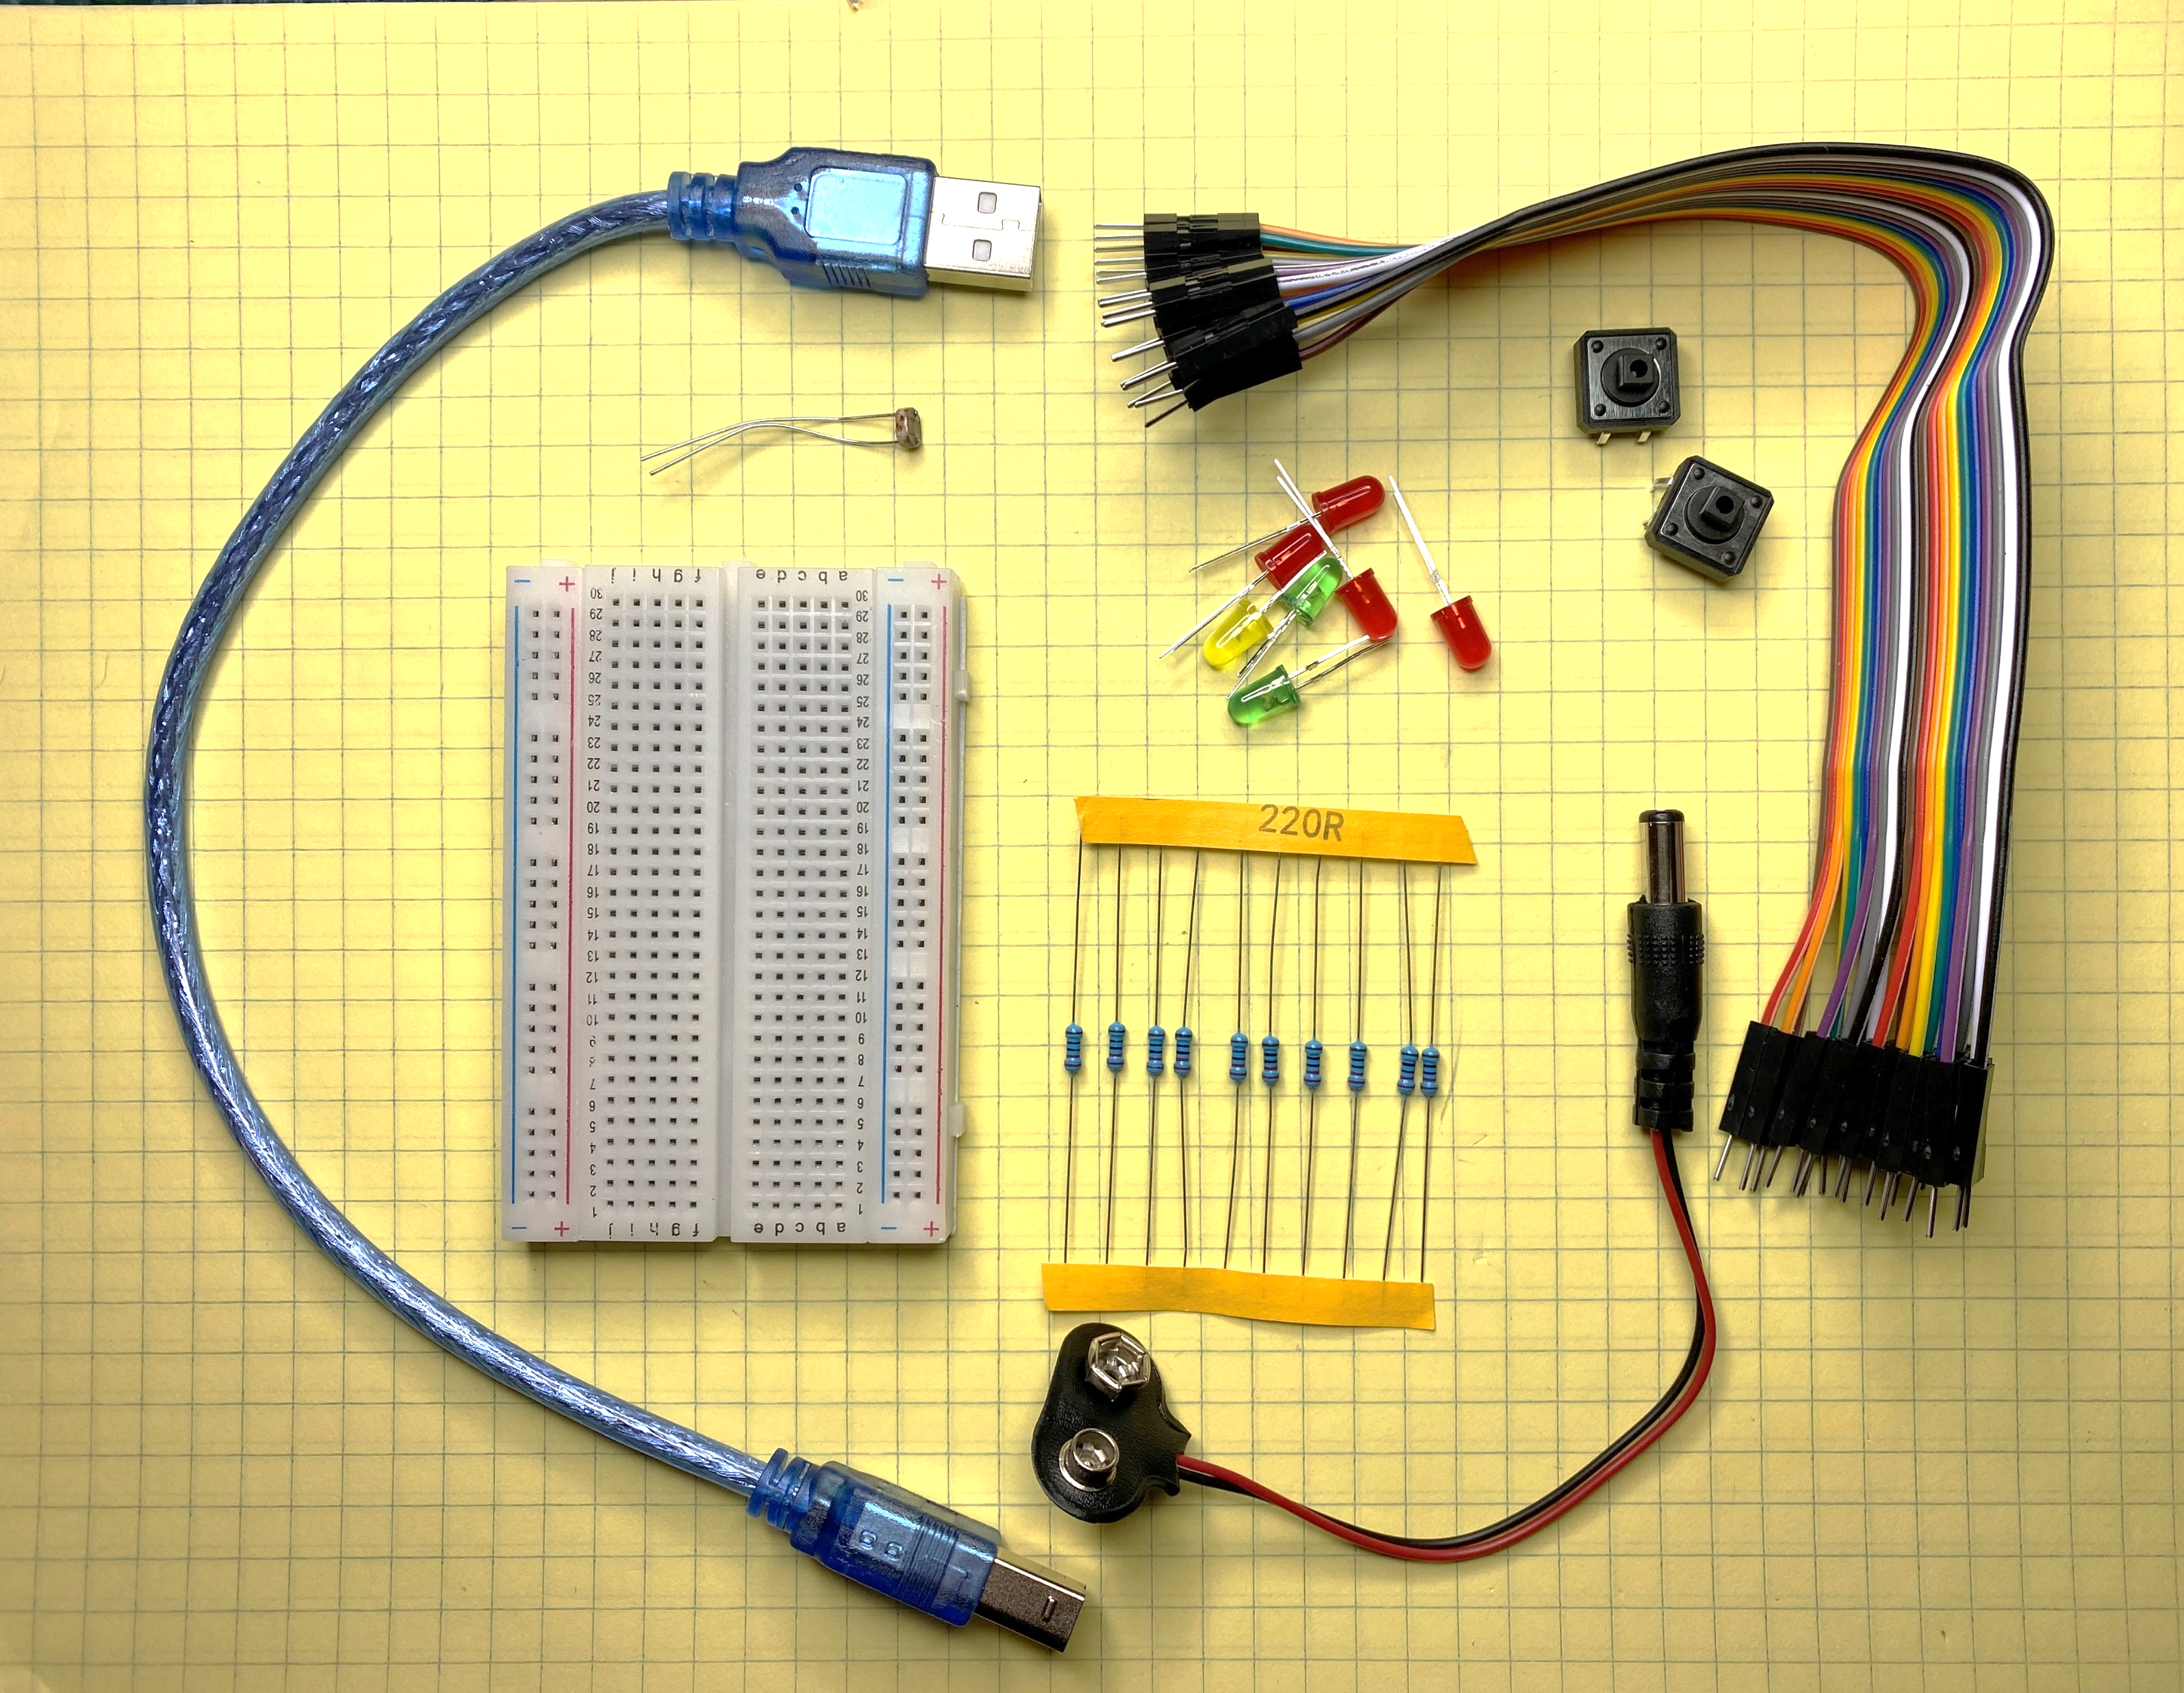
Arduino Parts Kit
LEDs
Photocell
Jumper Wires
Switches
USB Programming and Power Cable
9V power cord
Breadboard
Resistors
Notes:
This is an example of the parts in an Arduino Starter kit. Power the Arduino with either the USB cord or from a 9V battery.

Slide 24
Stay Curious!
Use your Creativity!
Solve Problems
Make a Better World

