Slide 1
Introduction to Orbits
Tycho Brahe and Johannes Kepler history
The Ellipse
Orbital Reference Planes
Orbital Parameters
Bruce Bream, LtCol/CAP
June 2024
Notes:
This presentation is focused on just what is needed to understand how to define the orbit of a satellite. We start with a little history, then understand definition of an ellipse, then look at each orbital parameter and finally put is all in one chart. We are skipping any mention of gravity and physics of why the orbits are ellipses. This is just to get you to a basic understanding of seven parameters that can define an orbit.

Slide 2
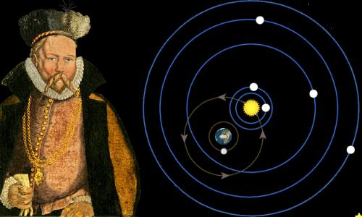
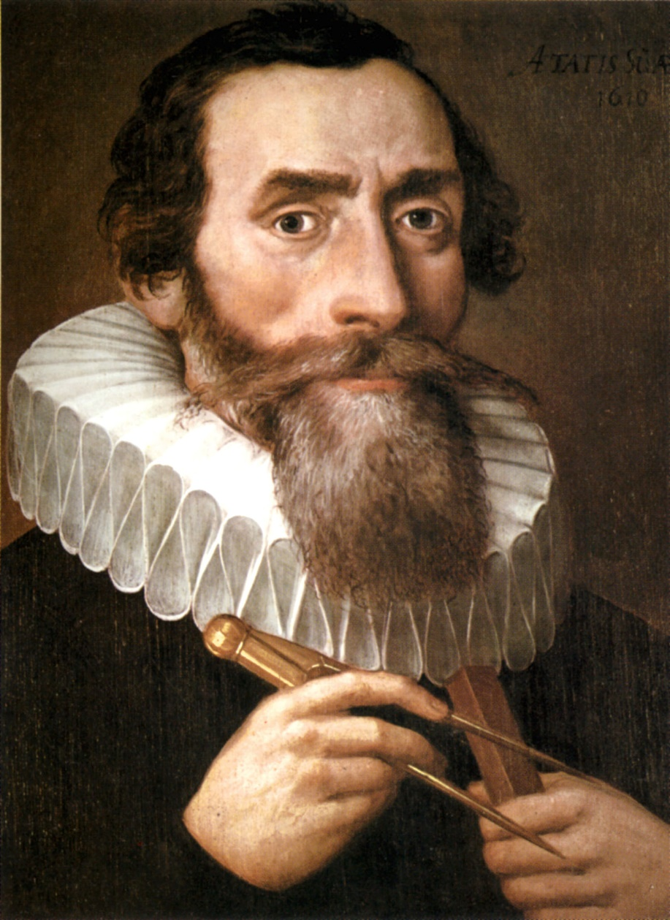
Two Scientists set the basis for Satellite Orbits
Tycho Brahe (1546-1601)
Detailed observations of Mars orbit
Johannes Kepler (1571-1630)
Used Tycho’s observations to develop the Laws of Planetary Motion
Image ref: Wikipedia
Notes:
Tycho made precision measurements of the planet Mars which enabled Kepler to develop his Laws of Planetary Motion. It took both to accomplish this groundbreaking understanding of the planetary motion and that of modern day satellites.

Slide 3
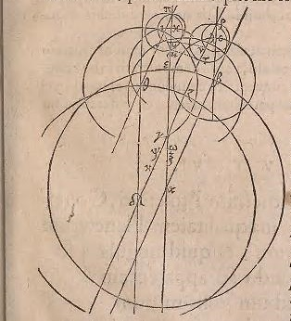
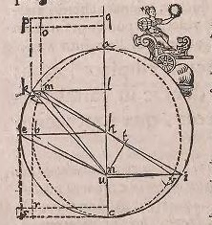
Kepler’s Astronomica Nova 1609
An 8 year treatise showing all his mistakes and dead ends trying to understand planetary orbits
An 8 minute (0.13 degree) discrepancy of Mars orbit led him to discover it was “egg” shaped
Eventually found it was a simple ellipse
Derived from observation & simple geometry
Image ref: Wikipedia
Notes:
Mars orbit is nearly, but not exactly a circle around the sun. That small discrepancy was pursued by Kepler in his Astronomica Nova for 8 years, showing all his mistakes and dead ends until he finally derived the Laws of Planetary Motion. Imagine writing a term paper showing all your mistakes and dead ends.

Slide 4
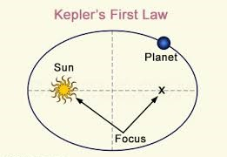
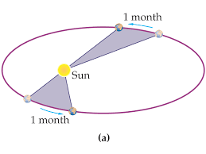
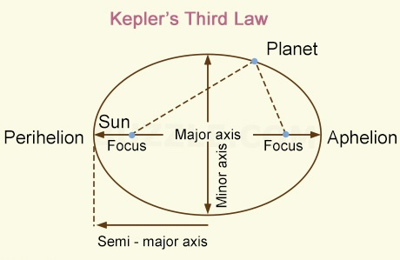
Kepler’s Laws of Planetary Motion (1609)
1. The Law of Orbits: All planets move in elliptical orbits, with the sun at one focus.
Orbits are not circles, the Sun is not at the center of the orbit
2. The Law of Areas: A line that connects a planet to the sun sweeps out equal areas in equal times.
Orbital speed changes
3. The Law of Periods: The square of the period of any planet is proportional to the cube of the semimajor axis of its orbit.
Time for one trip around depends on the distance between the two objects
Image ref: Wikipedia
Notes:
Kepler’s Laws. We will only address the first law in the following slides. Newtonian physics that involves gravitational effects is not addressed. We are only looking at a 2 body problem. N-body problems that involve other gravitational bodies, such as the sun and moon are not included.

Slide 5
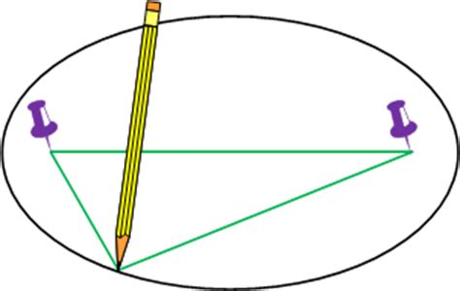
The Ellipse
8 years of study comes down to:
Two pushpins, string, and a pencil
Defined by:
Two foci
Length of the string
Mathmatics:
Sum of distance from both points is the same
Image ref: Wikipedia
Notes:
8 years of study comes down to a pencil, string, and two pushpins

Slide 6
Ellipse Measurements for Orbital Parameters
a - Semi-major axis
b – Semi-minor axis
c – Focus to middle of ellipse
e – Eccentricity = c/a
a
b
a
c
Eccentricity
Circle e = 0
Ellipse 0 < e < 1
Notes:
Semi-major axis (a) and Eccentricity (e) are the first two parameters to define an orbit. Semi-major axis defines the size of the orbit and ecentricity defines the shape. There are several math equations relating all the parameters.

Slide 7
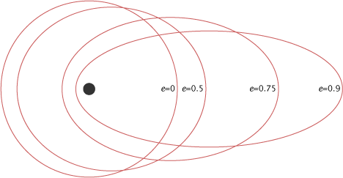
Eccentricity (e) /ĕk″sĕn-trĭs′ĭ-tē/
Eccentricity defines the shape of the orbit
Image ref: NASA GSFC

Slide 8

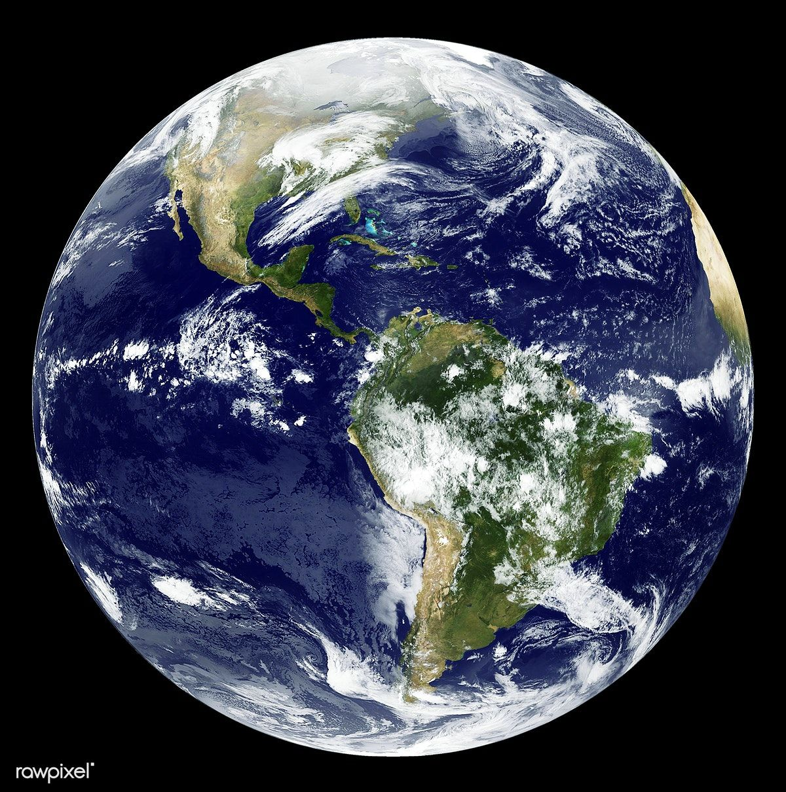
Satellite Motion and the Ellipse
Focus 1: Gravitational body
Focus 2: “Phantom” point
Notes:
Satellites follow an ellipse as discovered by Kepler. In this case, this satellite is orbiting the Earth in a highly elliptical orbit. The Earth is at one focus, the other focus is the phantom point.

Slide 9
Orbital Plane
Elliptical orbits lie in a flat 2D surface: a plane
Notes:
The satellite’s is in a flat 2D surface called a plane. Orbital planes can vary from being totally “flat” but we will assume this here. A gyroscope can be used to demonstrate how an object at high speed, constrained to a center point, rotates in a plane. It also show how hard it is to change the plane of the orbit as the speed increases.

Slide 10
Perigee and Apogee (Earth centric)
Peri – Near
Perigee
Apo – Far
Apogee
Perigee is a point on the orbit closest to Earth
Earth Perigee & Apogee
Sun Perihelion & Aphelion
Lunar Perilune & Apolune
Any Periapsis & Apoapsis
Notes:
Peri – Latin for around or about; Apo – Greek for away from. The suffix refers to the gravitational reference body. The perigee is a reference point used for angular measurement of the orbit.

Slide 11
Angular Measurements
60°
135°
Angles are measured
counterclockwise
0°
270°
° = degrees
360° in a circle
Notes:
Angles are measured counterclockwise for all orbital parameter.

Slide 12
Geocentric Celestial Longitude Reference
Ecliptic
Longitude reference plane
Earth’s equator
= Celestial equator
Longitude zero direction
Spring/Vernal equinox
Intersection of two planes
First point of Aries (^)
Celestial Equator
^
^ is astronomy symbol for constellation Aries
Notes:
Geocentric reference puts the earth at the origin of angular measurements relative to the Earth’s equator. Celestial zero longitude is when the ecliptic intersects the equator and points at the first point of Aries in the Spring.

Slide 13
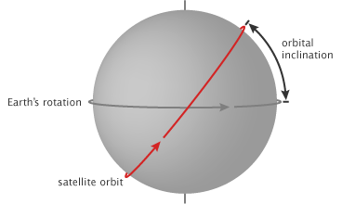
Orbital plane Inclination (i)
Angle of orbital plane
relative to Earth’s equator
- 0 to 90 degrees
0° – Equatorial
0° to 90° – Inclined
90° – Polar
Image ref: NASA GSFC
Notes:
Orbital inclination is another orbital parameter. It is measured relative to the Earth’s equator.

Slide 14
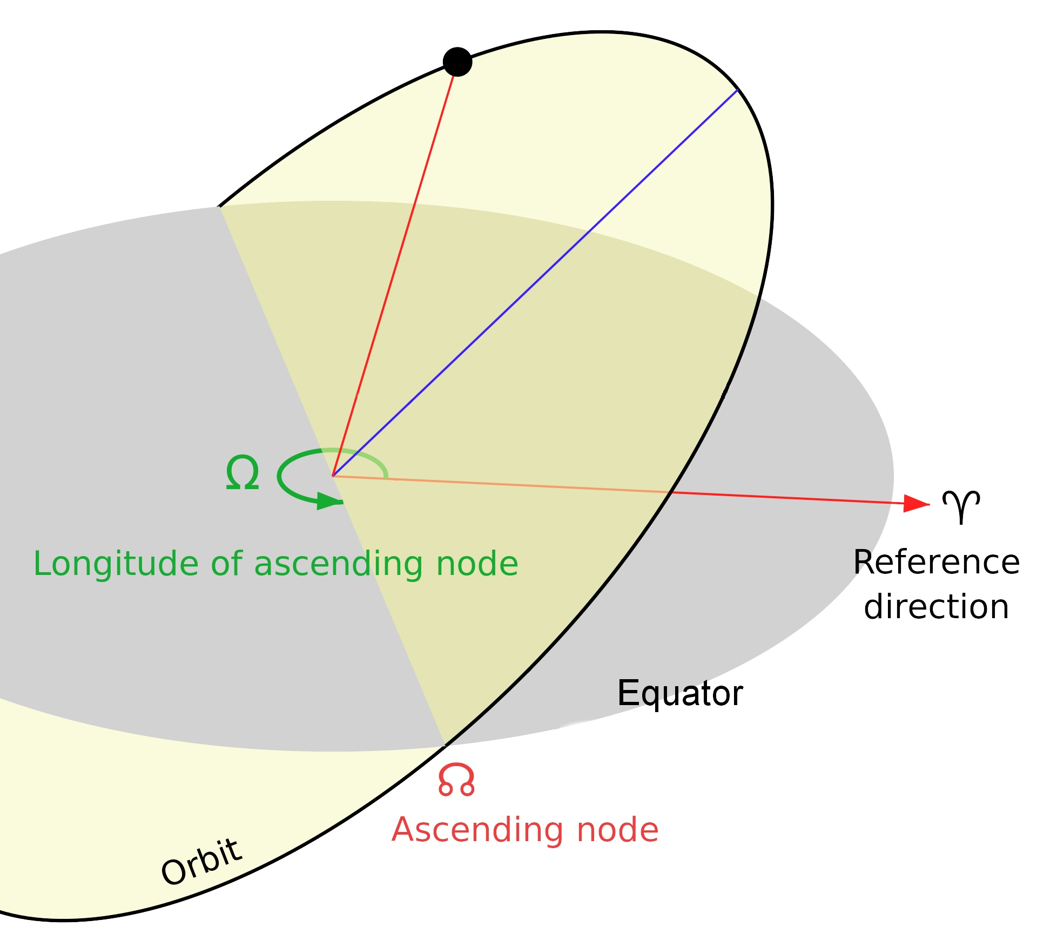
Ascending Node (Ω)
Angle from:
Earth celestial longitude zero
- First point of Ares ^
To:
Point orbital plane crosses
above ecliptic plane
from south to north
Ω also referred to as:
Right Ascension of Ascending Node (RAAN)
or
Longitude of Ascending Node
Image ref: Wikipedia
Notes:
The Ascending node defines the orientation of the ellipse relative to the vernal equinox.

Slide 15
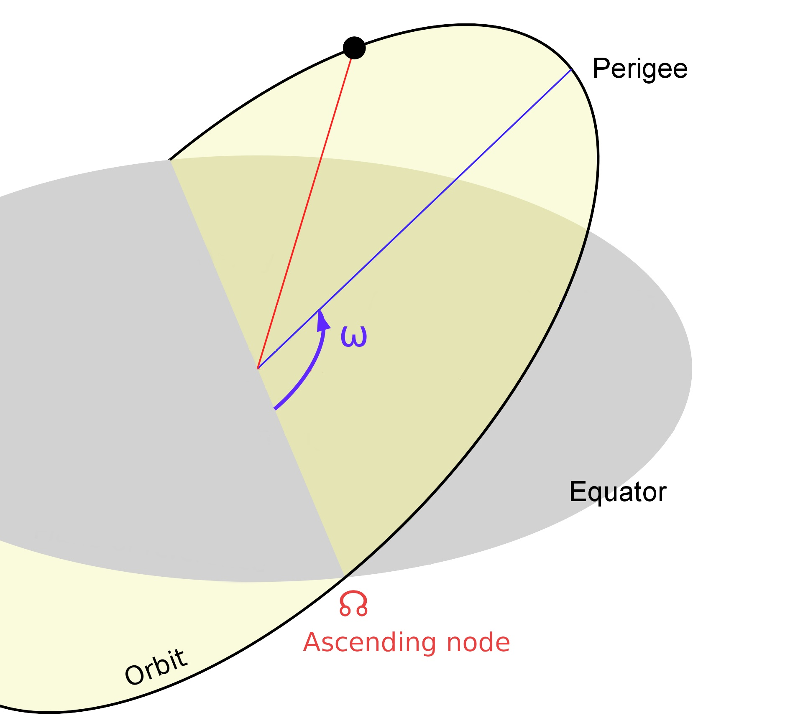
Argument of Perigee (ω)
Angle from:
Ascending node
to
Perigee
Sometimes abbreviated as: AP
Image ref: Wikipedia

Slide 16
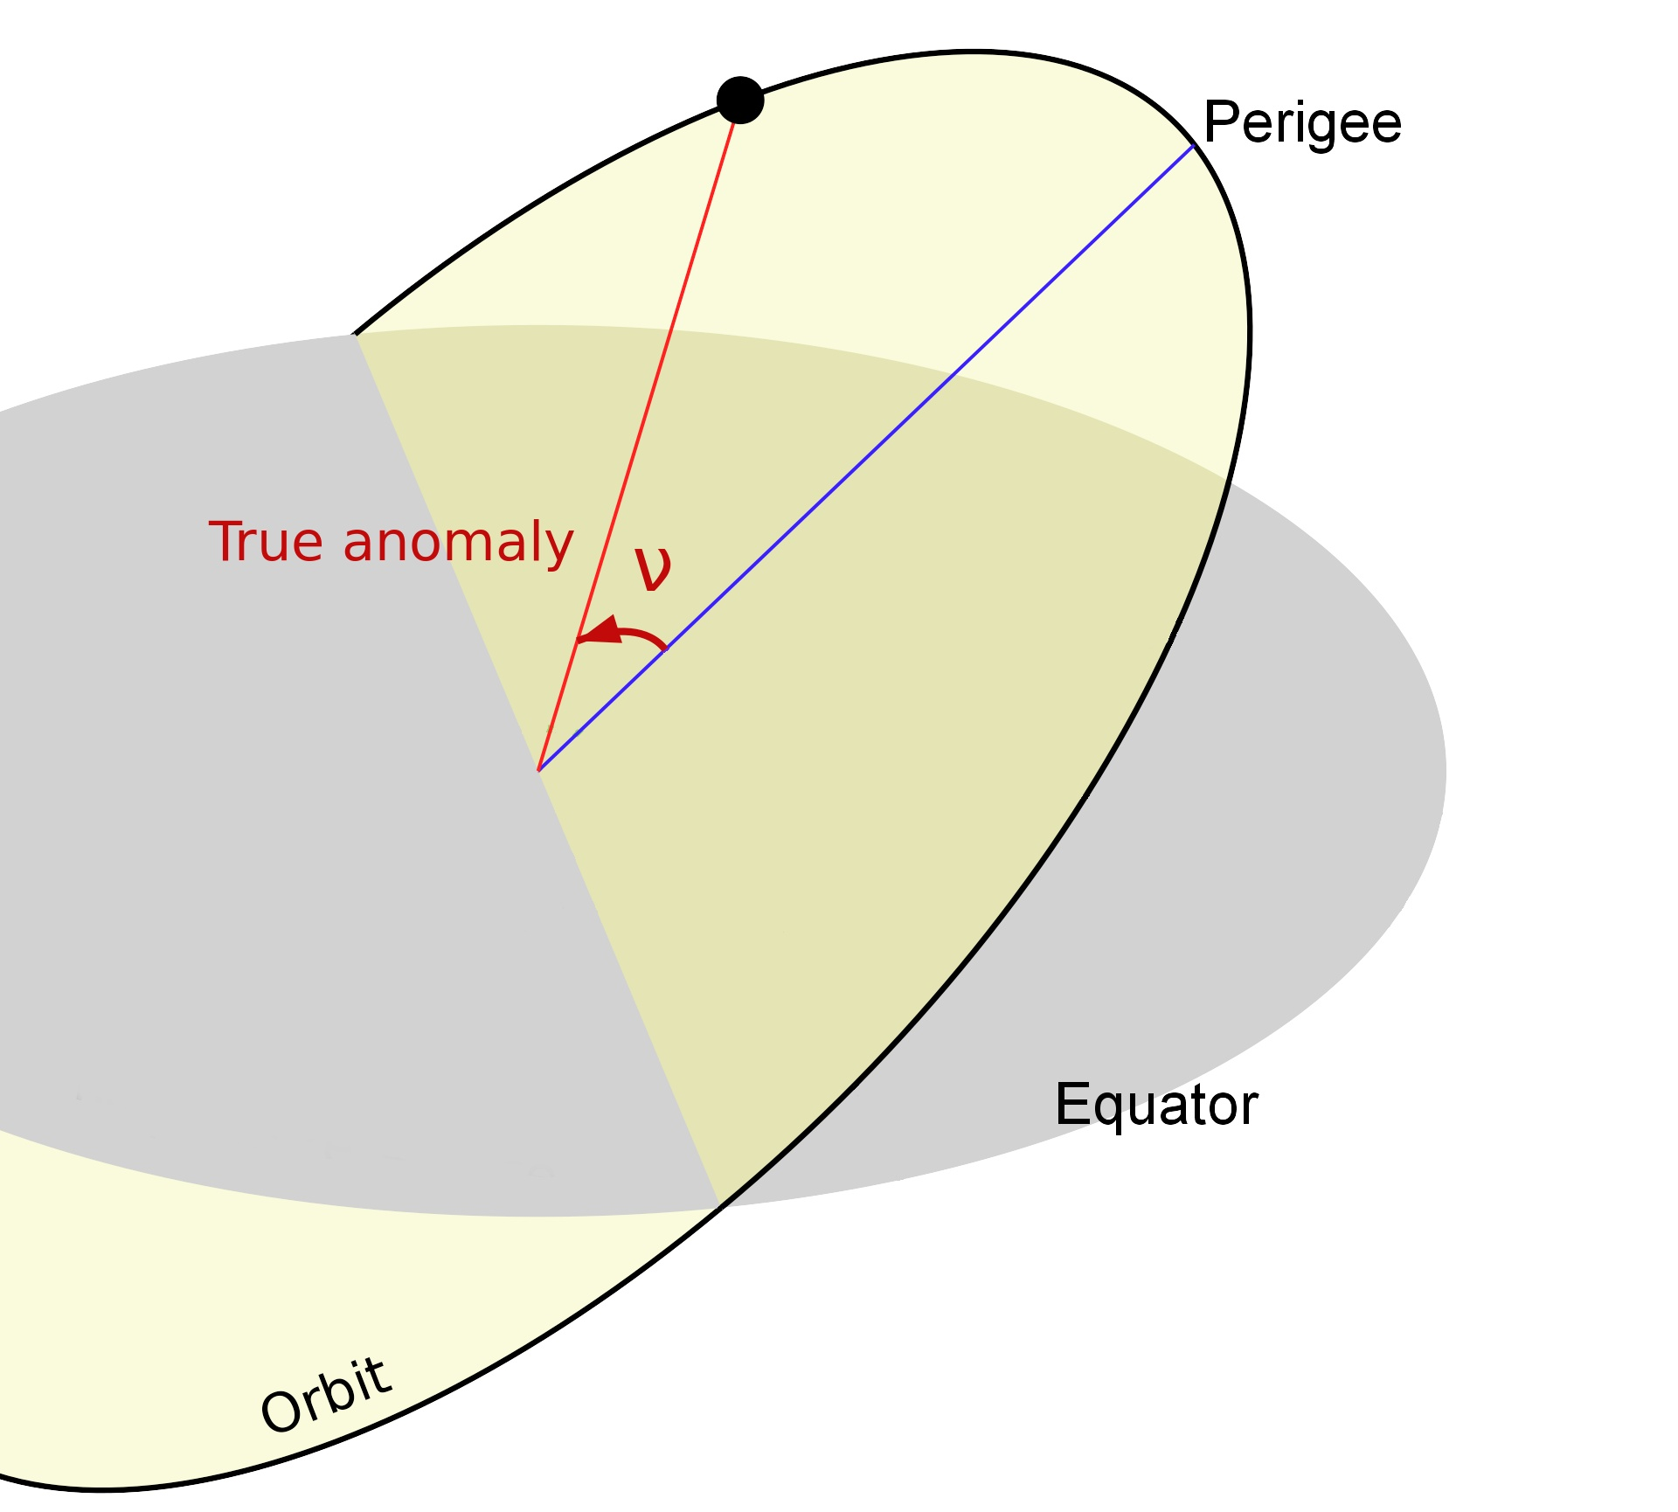
True Anomaly (ν) and Epoch (τ)
True Anomaly
Satellite location on orbit plane
Measure from:
Perigee to satellite
Epoch
Time at that location
Allows future prediction
Sometimes abbreviated as: TA
Image ref: Wikipedia
Notes:
The last two parameters are the angular location of the satellite (True Anomaly), and the time it was at that position (Epoch)

Slide 17
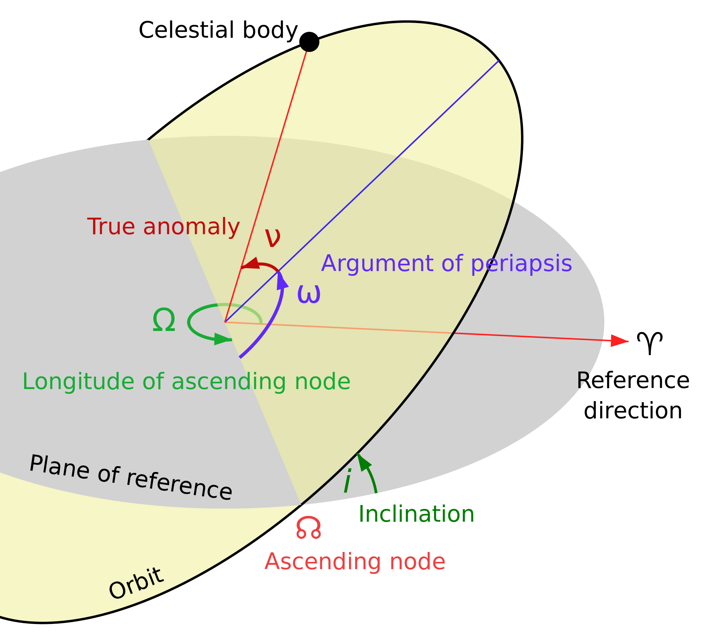
Seven Orbital Parameters
Ellipse:
- Semi-major Axis (a)
- Eccentricity (e)
Orbital Plane:
- Longitude of Ascending Node
- Inclination (i)
- Argument of Perigee (AP)
Location on the Ellipse:
True Anomaly (ν)
Epoch (τ)
Image ref: Wikipedia
Notes:
Putting it together, these are the seven orbital parameters. Two define the ellipse. Three define the orbital plane. Two define the position of the satellite on its elliptical orbit.

