Slide 1
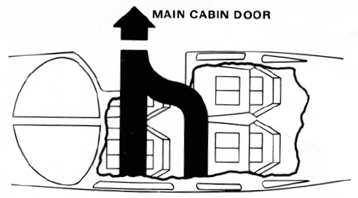
Piper Arrow III
N12345
GENERAL INFORMATION
EMERGENCY INFORMATION
SEAT ADJUSTMENTS
EMERGENCY EXIT
Front Seat
Fore & Aft
Seat Adjustment
Seat Back Release
Check that seat position is latched
HEADSET / INTERCOM
To tilt passenger seat forward:
Turn knob (1) clockwise
Push seat forward
Volume: upper right panel & headset
Mike should be ½” from lips
Mike is always active for passengers
Turn on noise cancelling
Sample Only
Modify for your aircraft
HEAT / AIR CONTROLS
Vents overheat and on floor
Heat/Defrost on right panel
MAIN CABIN DOOR OPERATION
IN-FLIGHT PROTOCOL
No conversation when talking on radio
Sterile cockpit for landing and takeoff
Announce Aircraft, Terrain, and Obstacles
No adjustment of instruments or switches
Mike button on control wheel
Switching flight controls (You Have, I Have)
No Portable Electronic Devices during IFR
To open cabin door:
Twist UPPER latch (2) Forward
Lift LOWER latch (3) Up
Push door open
FASTEN SEAT BELTS
NO SMOKING
FIRE EXTINGUISHER
Fasten seat belt & shoulder harness for take off & landing
Insert latch into buckle & pull belt snug
To release belt, pull up on lip of buckle
No Smoking or Vaping
Air sickness bag behind seat
Under Front Passenger seat
EMERGENCY LANDING
Slide seat to rearmost position
Tighten seatbelt
Unlatch door
Transponder 7700, Radio 121.5
Survival equipment in baggage area
EXITING
Do not exit until engine has stopped
Only step on black area of wing

