Slide 1
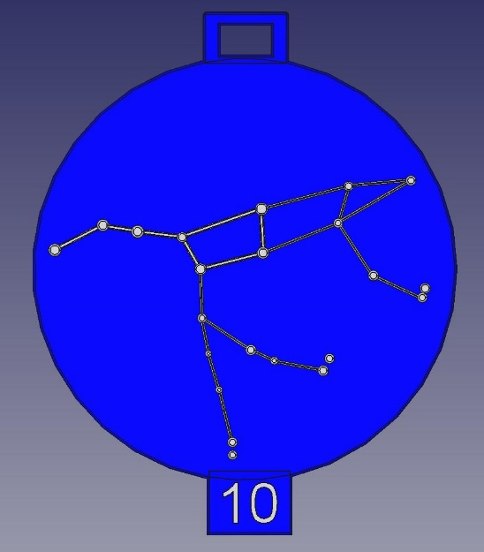
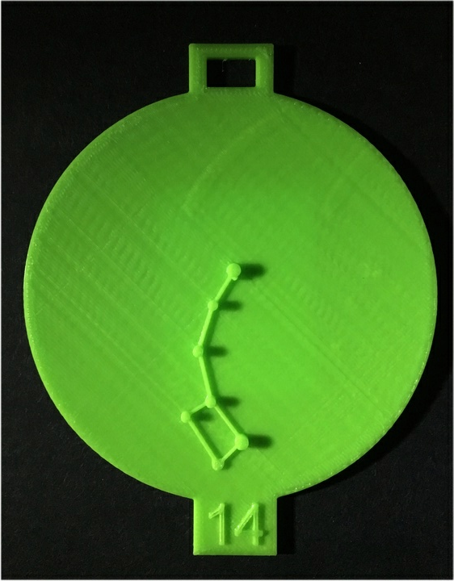
Star Coins - Tactile Constellations for the Visually Impaired
Concept
Star Coins are 3D printable constellations
Printable on any 3D printer
Brings astronomy to the visually impaired
About
Started in October 2014 in collaboration with the Cleveland Museum of Natural History and the Cleveland Sight Center
Design
Single constellation on a disk
50 cm diameter
Beaded chain loop on top
Index number on bottom
Add magnetic material on back (optional)

Slide 2
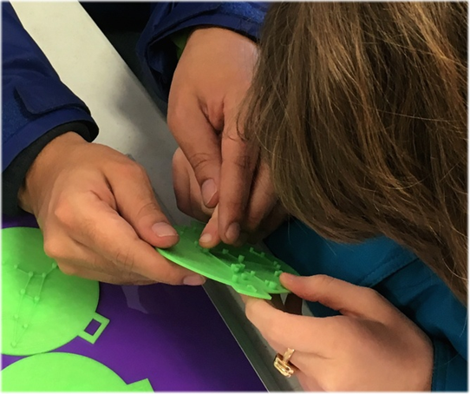
Star Coins - Tactile Constellations for the Visually Impaired
Teaching Ideas
Introduction to constellations and quiz
  Describe constellations
  Quiz students using number on disk
Legends of the constellations
  Done with most presentations
Assist with planetarium shows
  Hand out constellations on a beaded chain
  Refer to number on disk during show

Slide 3
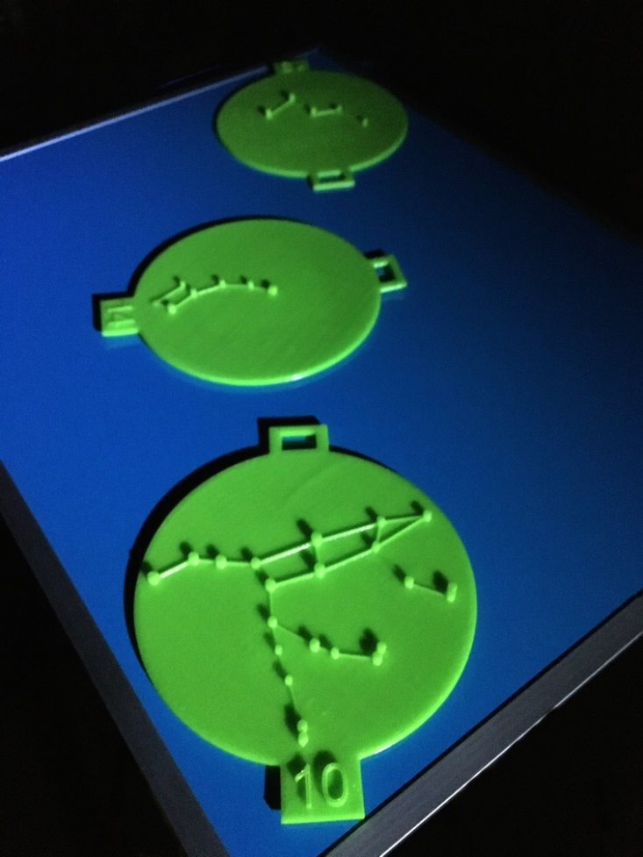
Star Coins - Tactile Constellations for the Visually Impaired
Teaching Ideas
Oriented placement
  Describe three polar constellations
  Place Uma & Cas pointing at Umi
  Use magnetic sheet material attached to back of the constellation and a magnet board
  Pivot board to simulate rise and set
  Hold board overhead

Slide 4
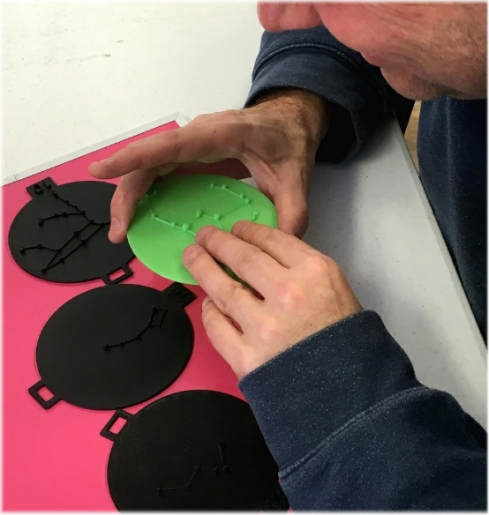
Star Coins - Tactile Constellations for the Visually Impaired
Utilization
Some experience with Cleveland Sight Center
Encouraging use by others
Looking for:
  Feedback from users
  Suggestions for design changes
  Teaching methods that have worked
Direct Inquiries to:
    Bruce Bream
    tarrow@roadrunner.com
    www.rovingbits.com/StarCoins/

Slide 5
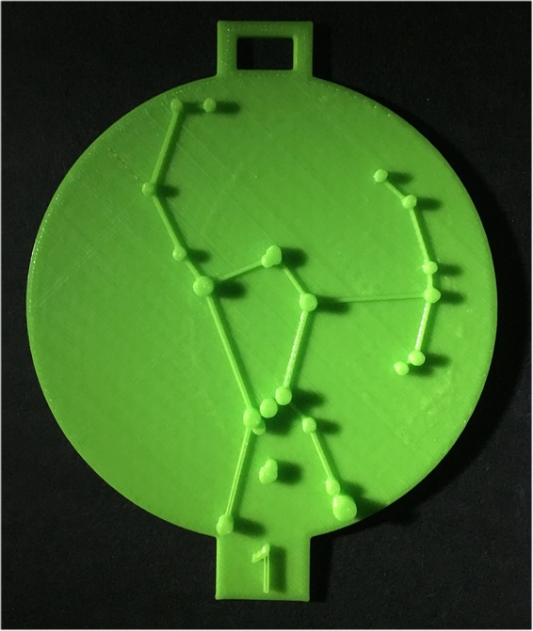
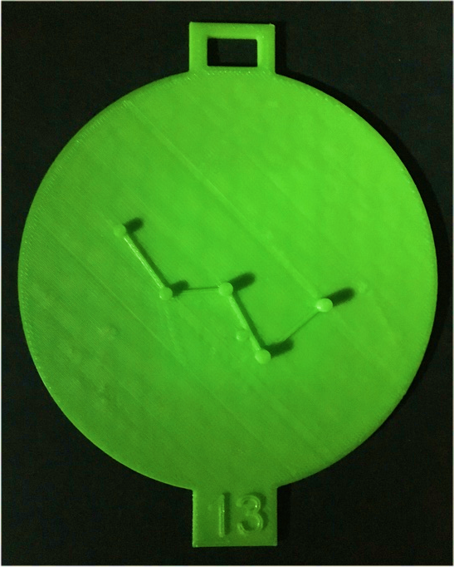
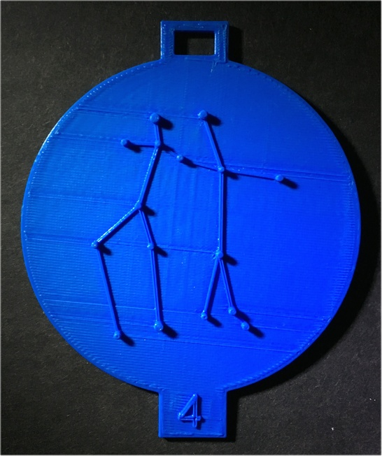
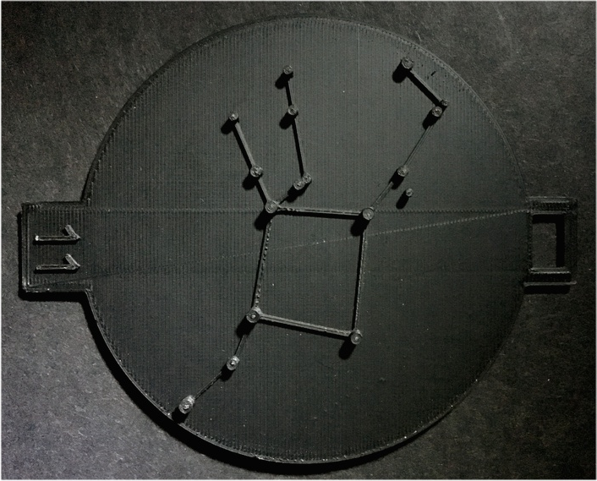
Star Coins - Tactile Constellations for the Visually Impaired
www.rovingbits.com/StarCoins/

