Slide 1
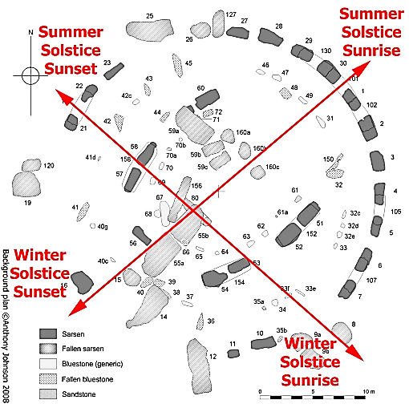
Stonehenge

Slide 2
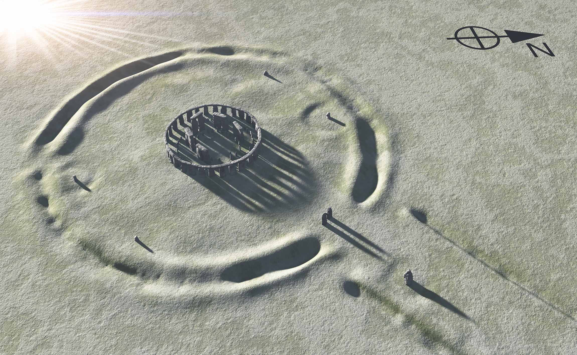
WINTER SOLSTICE SUNSET

Slide 3
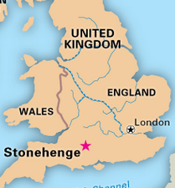
Stonehenge Info Sheet
Location: Soutwest England
Built: about 2000-3000 B.C.E.
Standing Stones (Sarasens):
Height: 13 feet (4.0 m)
Width: 7 feet (2.1 m)
Thickness: 3.6 feet (1.1 m)
Diameter: 108 feet (33 m)
Number: 30 in circle
Weight: 25 tons (22.6 metric tons)
Design: Rough tongue and groove
Quarried: 25-150 miles (40-240 km)
Lintel Stones:
Length: 10 feet (3.2 m)
Width: 3.3 feet (1 m)
Thick: 2.8 feet (0.8 m)
Tops: 16 feet above ground (4.9m)
Heel Stone:
Location: Northeast of circle
Height: 16 feet (4.9 m)
AKA: Friar’s Heel, Sun Stone
Significance: Summer solstice sunrise over stone
Due to 23.5 degree tilt of Earth axis
Summer Winter
Sunrise NE SE
Sunset NW SW
Winter Solstice:
~ 8 hours of daylight
Sunrise/Sunset farthest south
Summer Solstice:
~16 hours of daylight
Sunrise/Sunset farthest north

